Slide 1
Engaging in COP27: A Training for Indigenous Peoples
Thursday 27 October 2022

Slide 2
Welcome
Roberto Borrero, Tribal Link Foundation

Slide 3
Agenda:
NDCs and UNDPs Climate Promise
NDCs as part of the Paris Agreement: Sameera Savarala
Climate Promise and social inclusion elements: Verania Chao
Examples of work with Indigenous Peoples on NDC process in the LAC region: Lorenzo Eguren
Q&A
Opening remarks by Rochelle Diver, International Indian Treaty Council (IITC)
History of Indigenous Peoples Engagement and opportunities to engage in the UNFCCC by Andrea Carmen, IITC
Entry points into UNFCCC negotiations and agenda for COP27 by Graeme Reed, International Indigenous Peoples Forum on Climate Change
Q&A

Slide 4
Opening Remarks
Rochelle Diver, International Indian Treaty Council

Slide 5
History of Indigenous Peoples Engagement and opportunities to engage in the UNFCCC
Andrea Carmen, International Indian Treaty Council

Slide 6
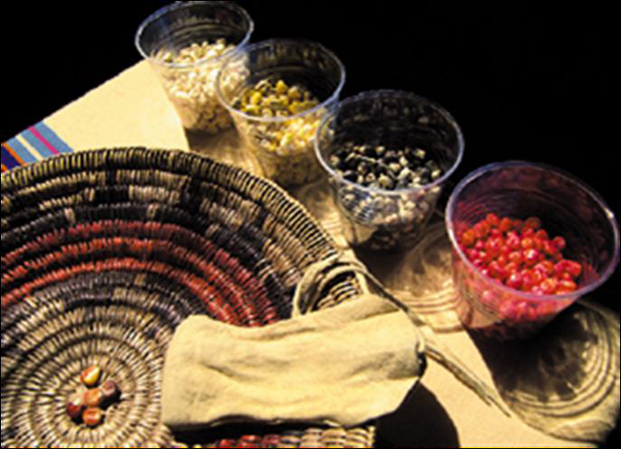
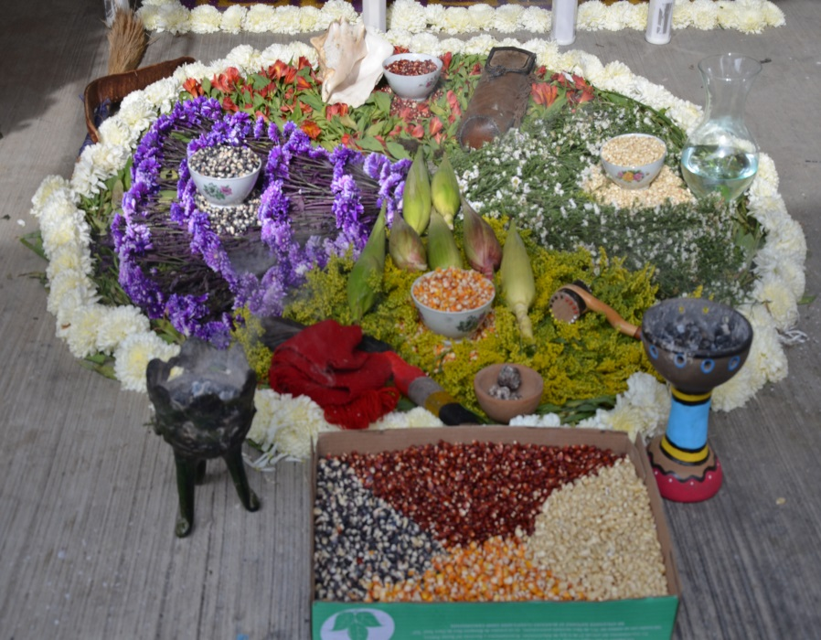
Defending our Rights and Ways of Life: Access to Climate Justice at the UNFCCC
Ceremonial Corn Altars, Tsaile Arizona and Oaxaca, México

Slide 7
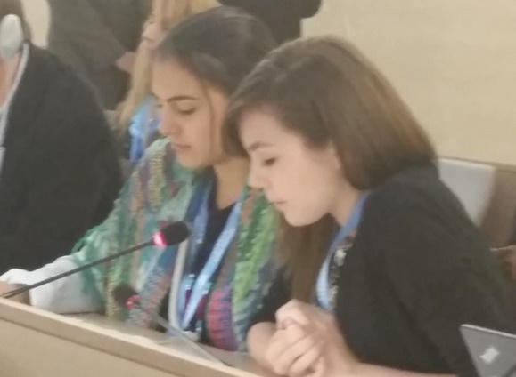
“Indigenous Peoples should speak for and represent themselves before the world community.” - IITC’s Guiding Principles
In 1977 IITC received UN Consultative Status, and was upgraded to General Status by ECOSOC in 2011
Nicole Yanes and Sewa Carmen present an intervention on Access to Justice for Indigenous Youth, UN Expert Mechanism on the Rights of Indigenous Peoples, July 2014, Geneva

Slide 8
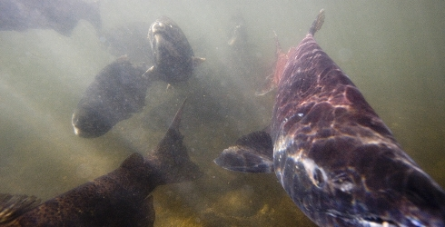
The Climate Crisis: the UN estimates that a million species face extinction
More than a million spring-run Chinook once lived in California Central Valley waters. In 2010 there were less than 10,000, a decline of 99%. UC Davis scientists predicted that due to climate change, even in the most hopeful scenarios, spring run Chinook salmon will not survive past 2099.

Slide 9
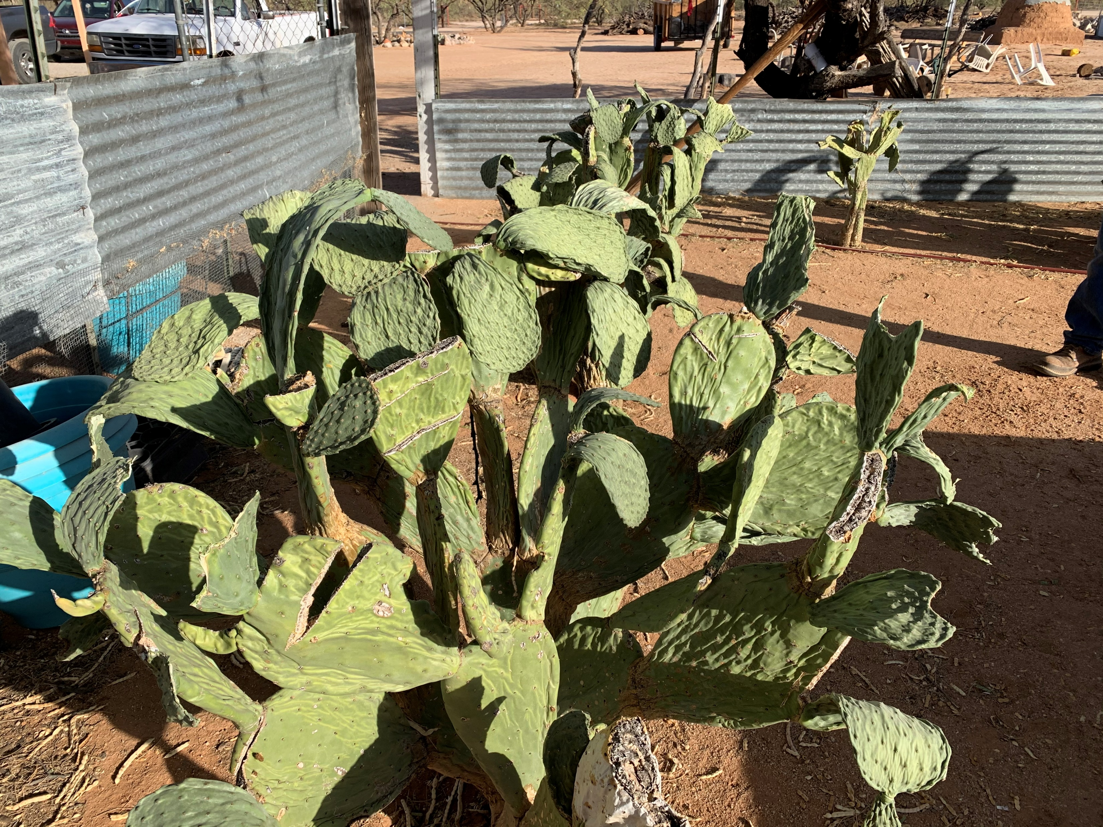
2020 was the hottest, driest year ever recorded in Tucson Arizona. The warmest seven years globally have all been since 2015. The top three were 2016, 2019 and 2020.

Slide 10
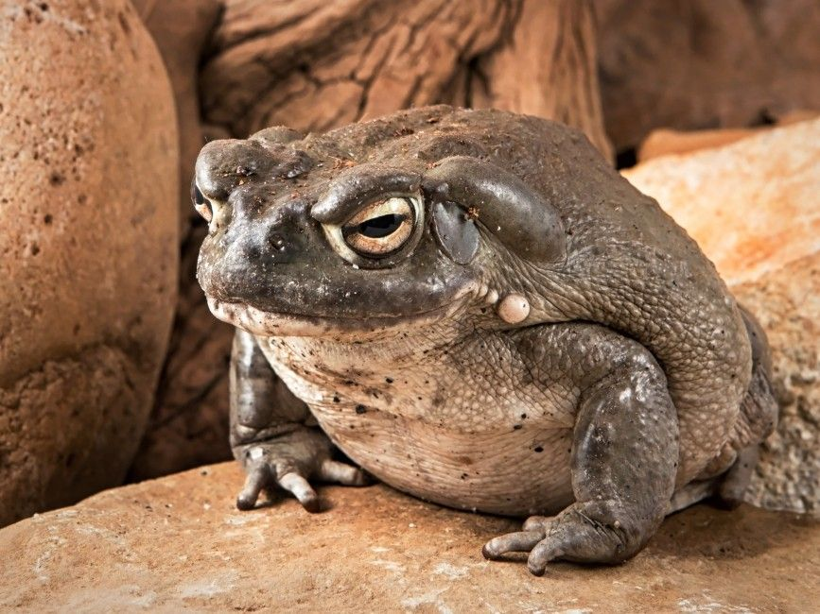

Slide 11
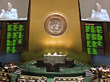
The United Nations General Assembly Adopts the UN Declaration on the Rights of Indigenous Peoples September 13th, 2007
UN News Service Photo

Slide 12
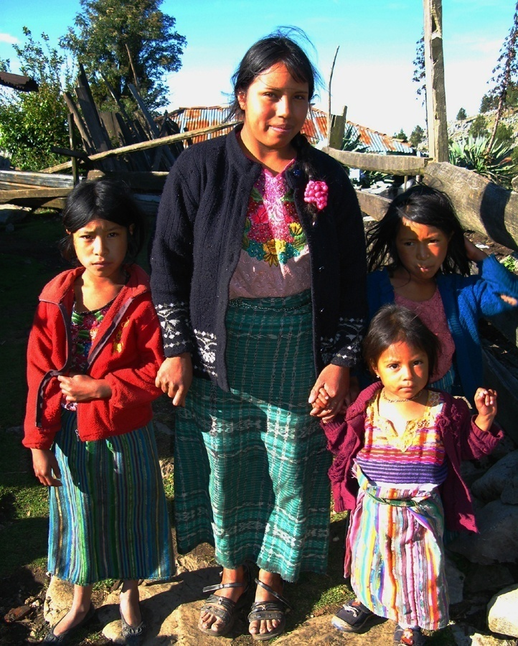
The Declaration is the “Minimum Standard”
“The rights recognized herein constitute the minimum standards for
the survival, dignity and well-being of the indigenous peoples of the world.” --Article 43

Slide 13
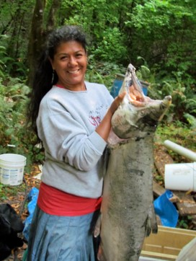
Subsistence Rights and Traditional Economies
“Indigenous peoples have the right to maintain and develop their political, economic and social systems or institutions, to be secure in the enjoyment of their own means of subsistence and development, and to engage freely in all their traditional and other economic activities.”
-- Article 20, paragraph 1

Slide 14
Lands, Territories and Resources
“Indigenous peoples have the right to the lands, territories and resources which they have traditionally owned, occupied or otherwise used or acquired…”
-- Article 26

Slide 15
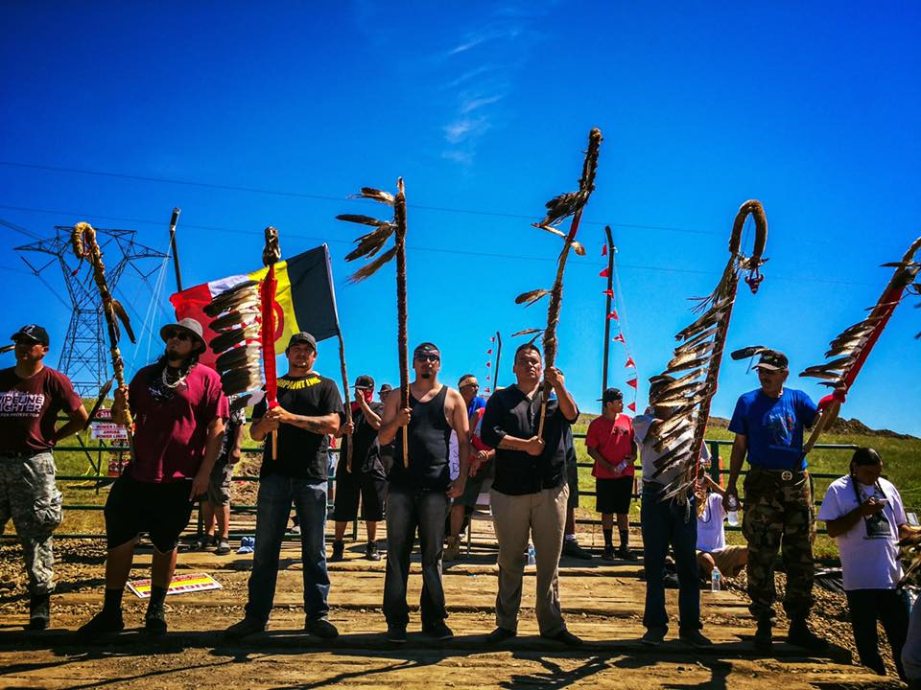
Article 32: FPIC and Development
“States shall consult and cooperate in good faith with the indigenous peoples concerned through their own representative institutions in order to obtain their free and informed consent prior to the approval of any project affecting their lands or territories and other resources...”
Standing Rock Water Protectors

Slide 16
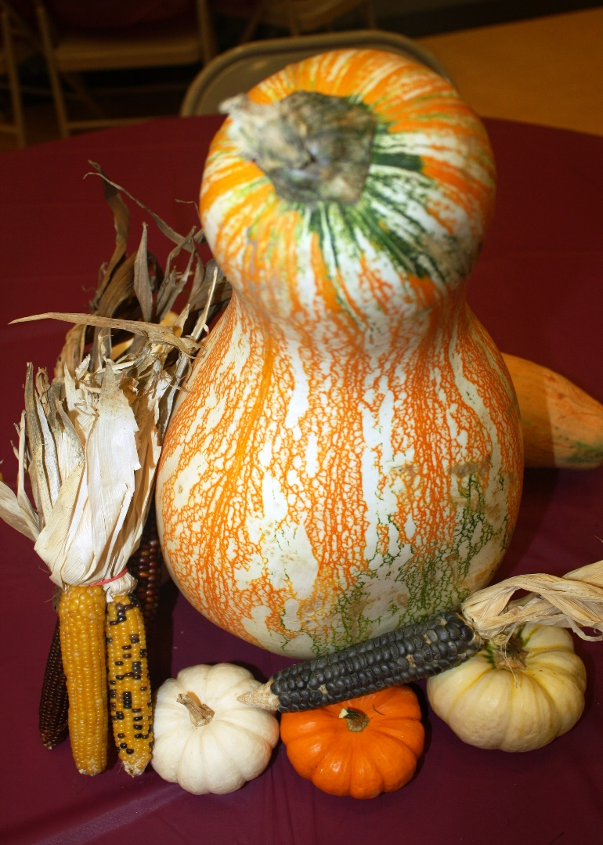
Environmental Protection and Productive Capacity of Lands
Indigenous peoples have the right to the conservation and protection of the environment and the productive capacity of their lands or territories and resources…
-- Article 29, para. 1

Slide 17
1. Indigenous peoples have the right to maintain, control, protect and develop their cultural heritage, traditional knowledge and traditional cultural expressions, as well as the manifestations of their sciences, technologies and cultures, including…seeds, medicines, knowledge of the properties of fauna and flora, oral traditions...
-- Article 31, UN Declaration on the Rights of Indigenous Peoples

Slide 18
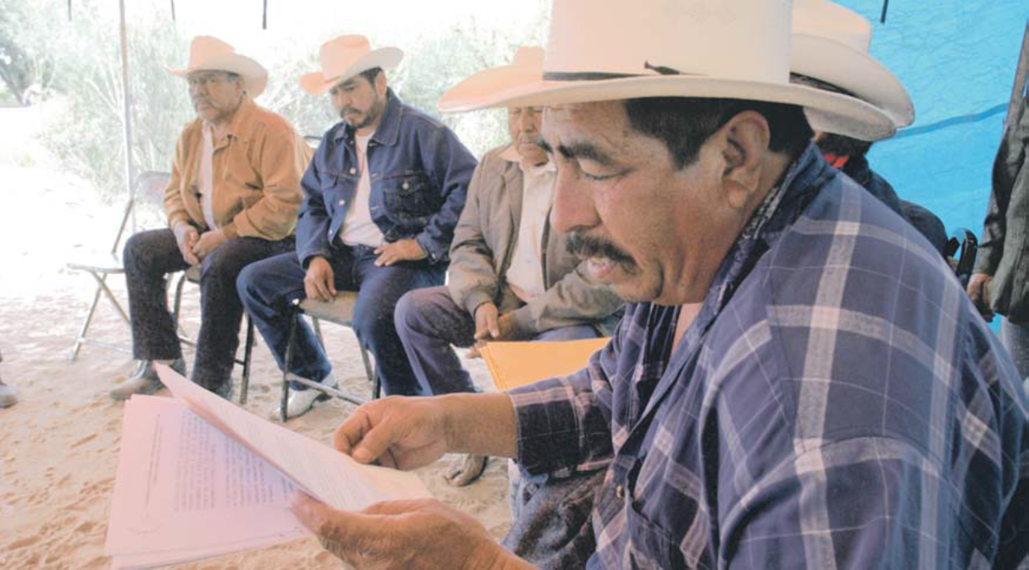
The Right to Participate in Decision-Making
Article 18: “Indigenous peoples have the right to participate in decision-making in matters which would affect their rights, through representatives chosen by themselves in accordance with their own procedures, as well as to maintain and develop their own Indigenous decision-making institutions.”

Slide 19
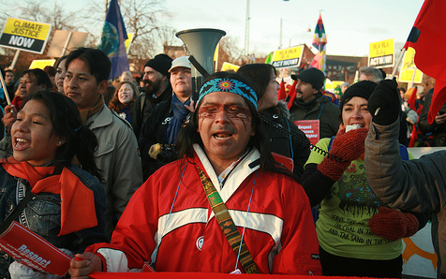
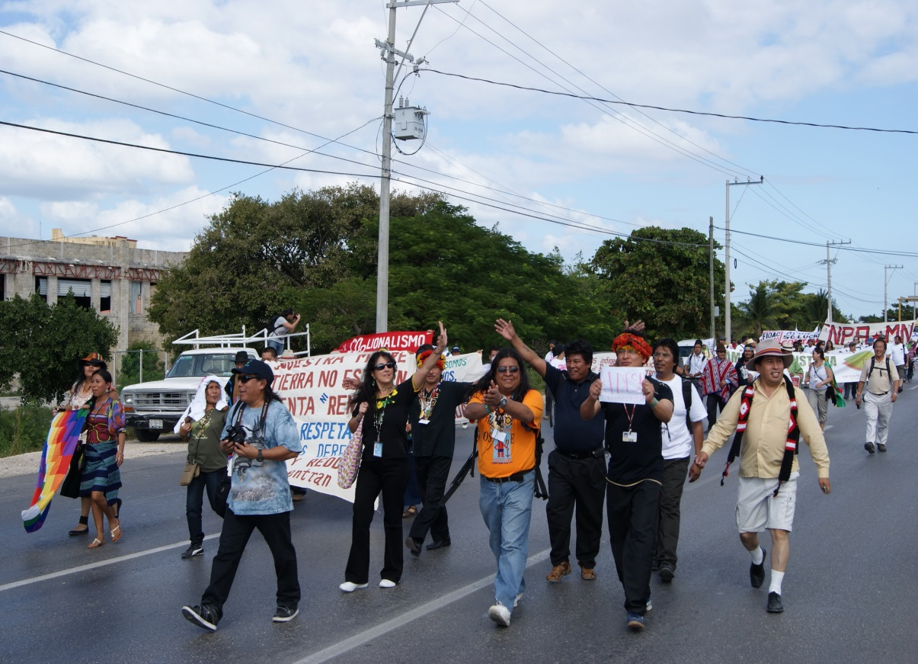
The United Nations Framework Convention on Climate Change (UNFCCC)
Indigenous Peoples march for rights and participation at COP 15, Copenhagen (2009) and COP 16, Cancun (2010)

Slide 20
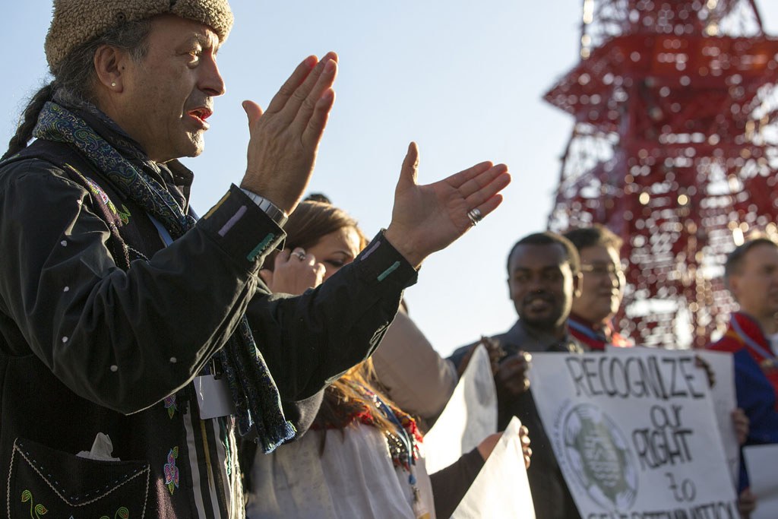
UNFCCC COP 21, Paris
November 30 – December 12, 2015

Slide 21
The Paris Agreement recognized the Rights of Indigenous Peoples
“Acknowledging that climate change is a common concern of humankind, Parties should, when taking action to address climate change, respect, promote and consider their respective obligations on human rights, the right to health, the rights of indigenous peoples, local communities, migrants, children, persons with disabilities and people in vulnerable situations...”
-- Preamble, the Paris Agreement, adopted by consensus December 12, 2015 to go into force in 2020

Slide 22
It also recognized Indigenous Peoples’ Traditional Knowledge and established a new “Exchange Platform”
Operative Paragraph 135: "Recognizes the need to strengthen knowledge, technologies, practices and efforts of local communities and indigenous peoples related to addressing and responding to climate change, and establishes a platform for exchange of experiences and sharing of best practices on mitigation and adaptation in a holistic and integrated manner."

Slide 23
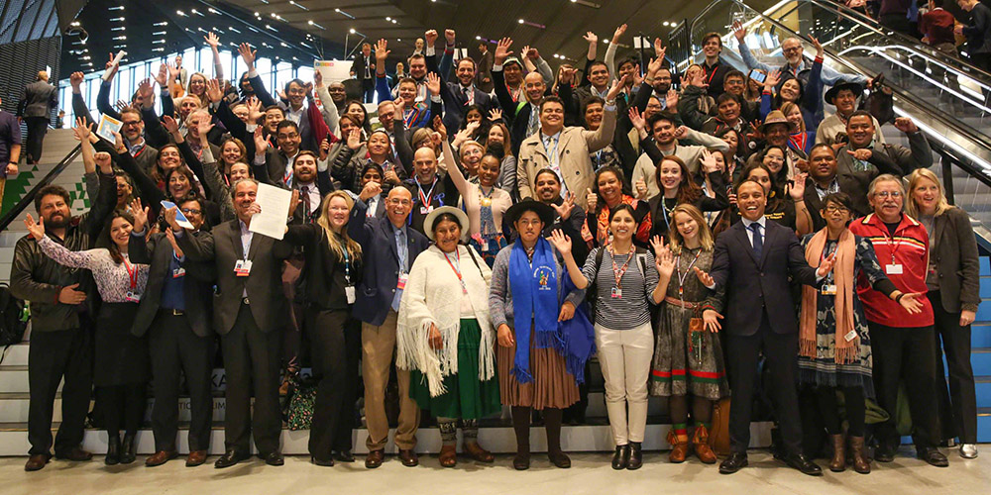
The Local Communities and Indigenous Peoples’ Platform (LCIPP) “operationalized” with the establishment of the Facilitative Working Group at COP 24, December 2018

Slide 24
2nd FWG meeting COP 25, Madrid, 2019: the first 2-year workplan was adopted

Slide 25
2nd FWG meeting COP 25, Madrid, 2019: the first 2-year workplan was adopted

Slide 26
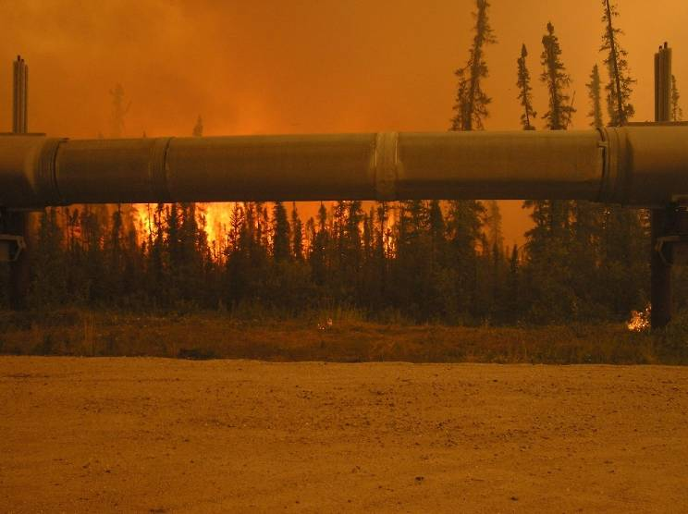
Keeping the increase to 1.5°C: COP 26 fell short …
In Paris, State Parties agreed to keep temperature rise to “well below” 2°C above pre-industrial levels, with a goal of 1.5°
The 2015 Structured Expert Dialogue (SED) report concluded that at 2°of warming “…indigenous people[s] would be at risk of loss of land and cultural and natural heritage, and cultural practices embedded in livelihoods would be disrupted.”
On August 9, 2021 the IPCC reported that the world will probably reach or exceed 1.5 degrees C of warming within the next two decades, with some changes already irreversible.

Slide 27
The temperature increase is 3X greater or more in the Arctic

Slide 28
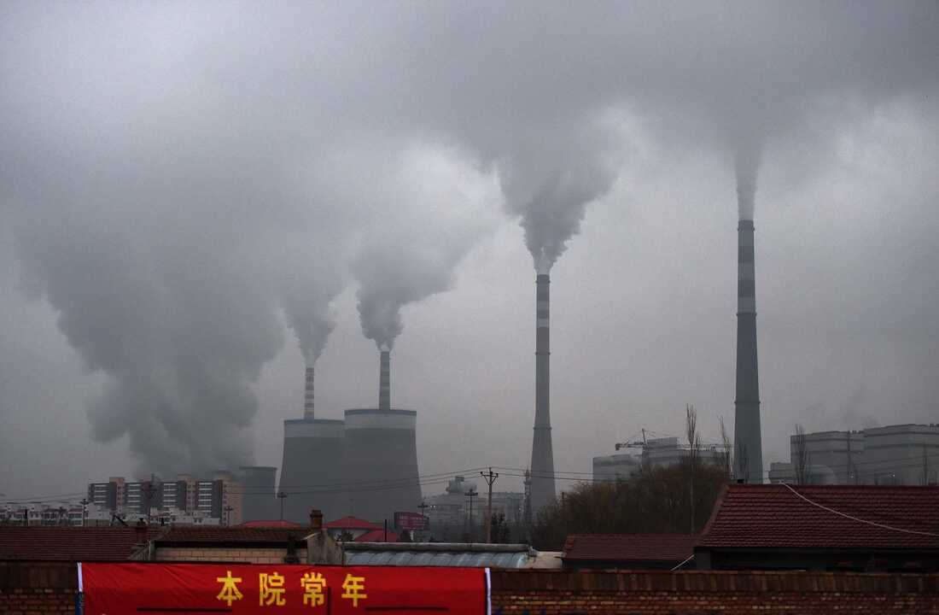
“Phasing down” replaced “phasing out” coal in the final outcome document – but fossil fuel emissions were mentioned for 1st time

Slide 29
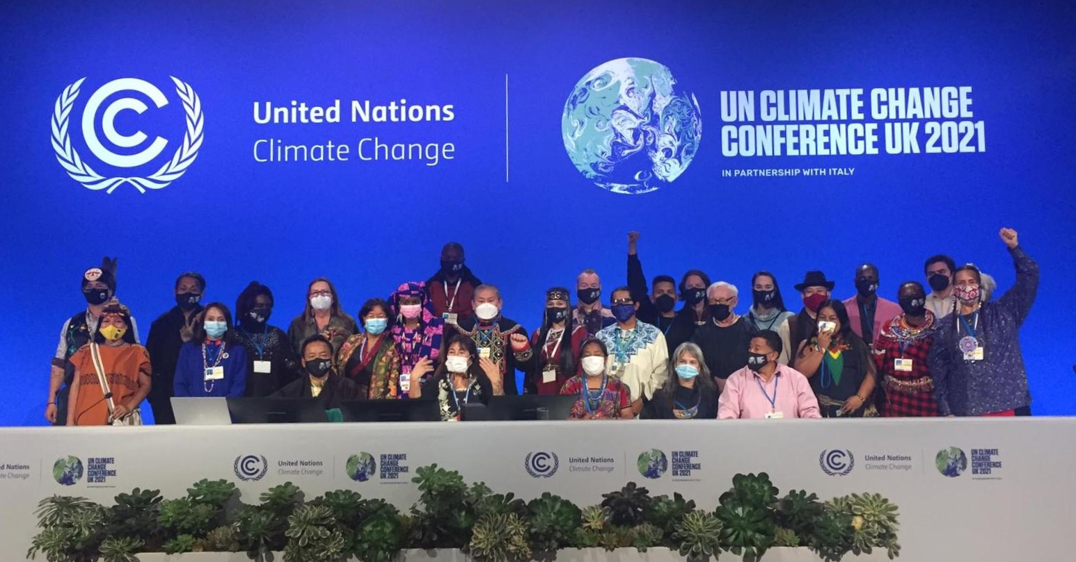
Indigenous Knowledge Holders and FWG members at COP 26

Slide 30
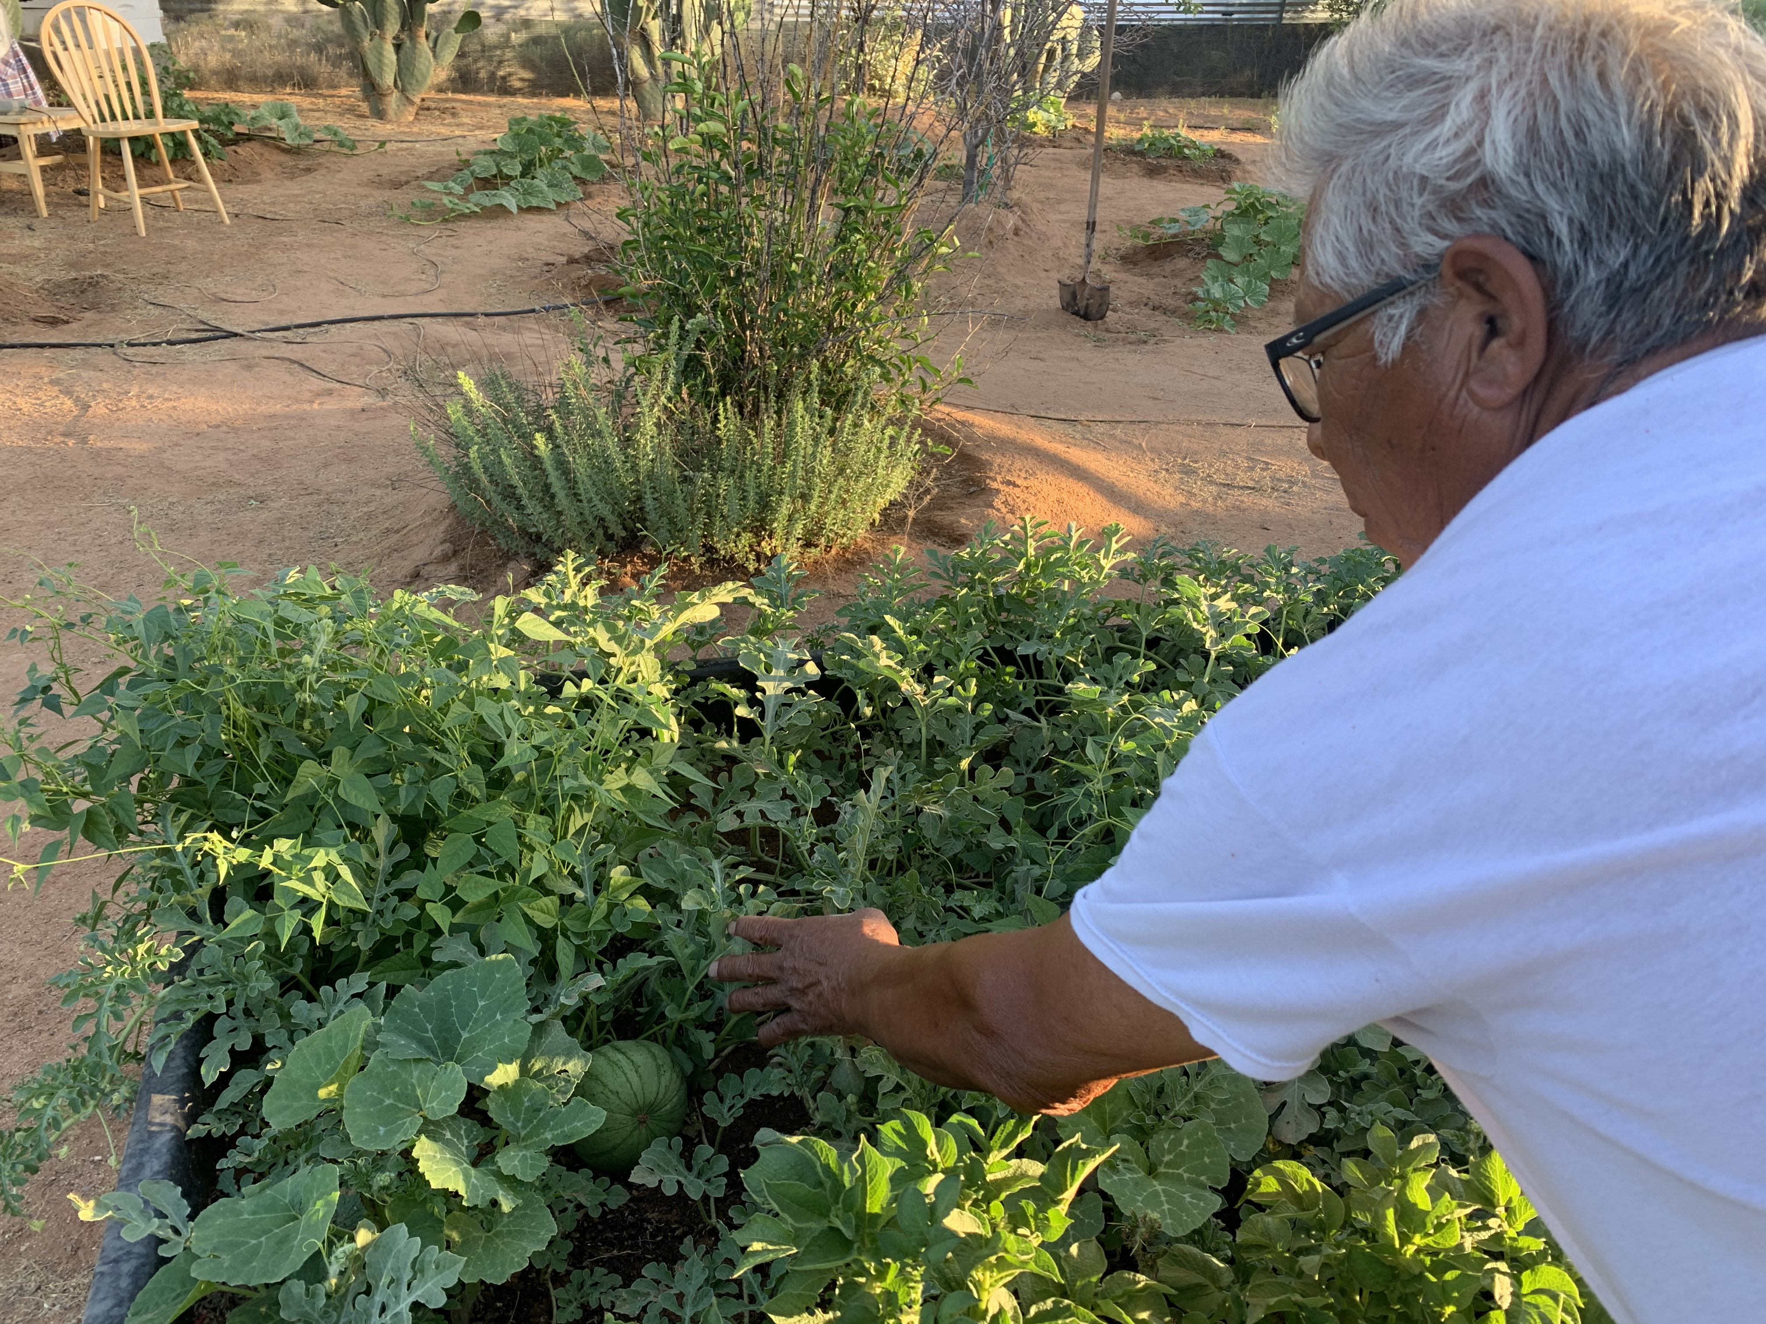
Reliance on our Traditional Foods and Medicines will be the basis of our surivival

Slide 31
Trading Original Seeds, especially drought resistant varieties

Slide 32
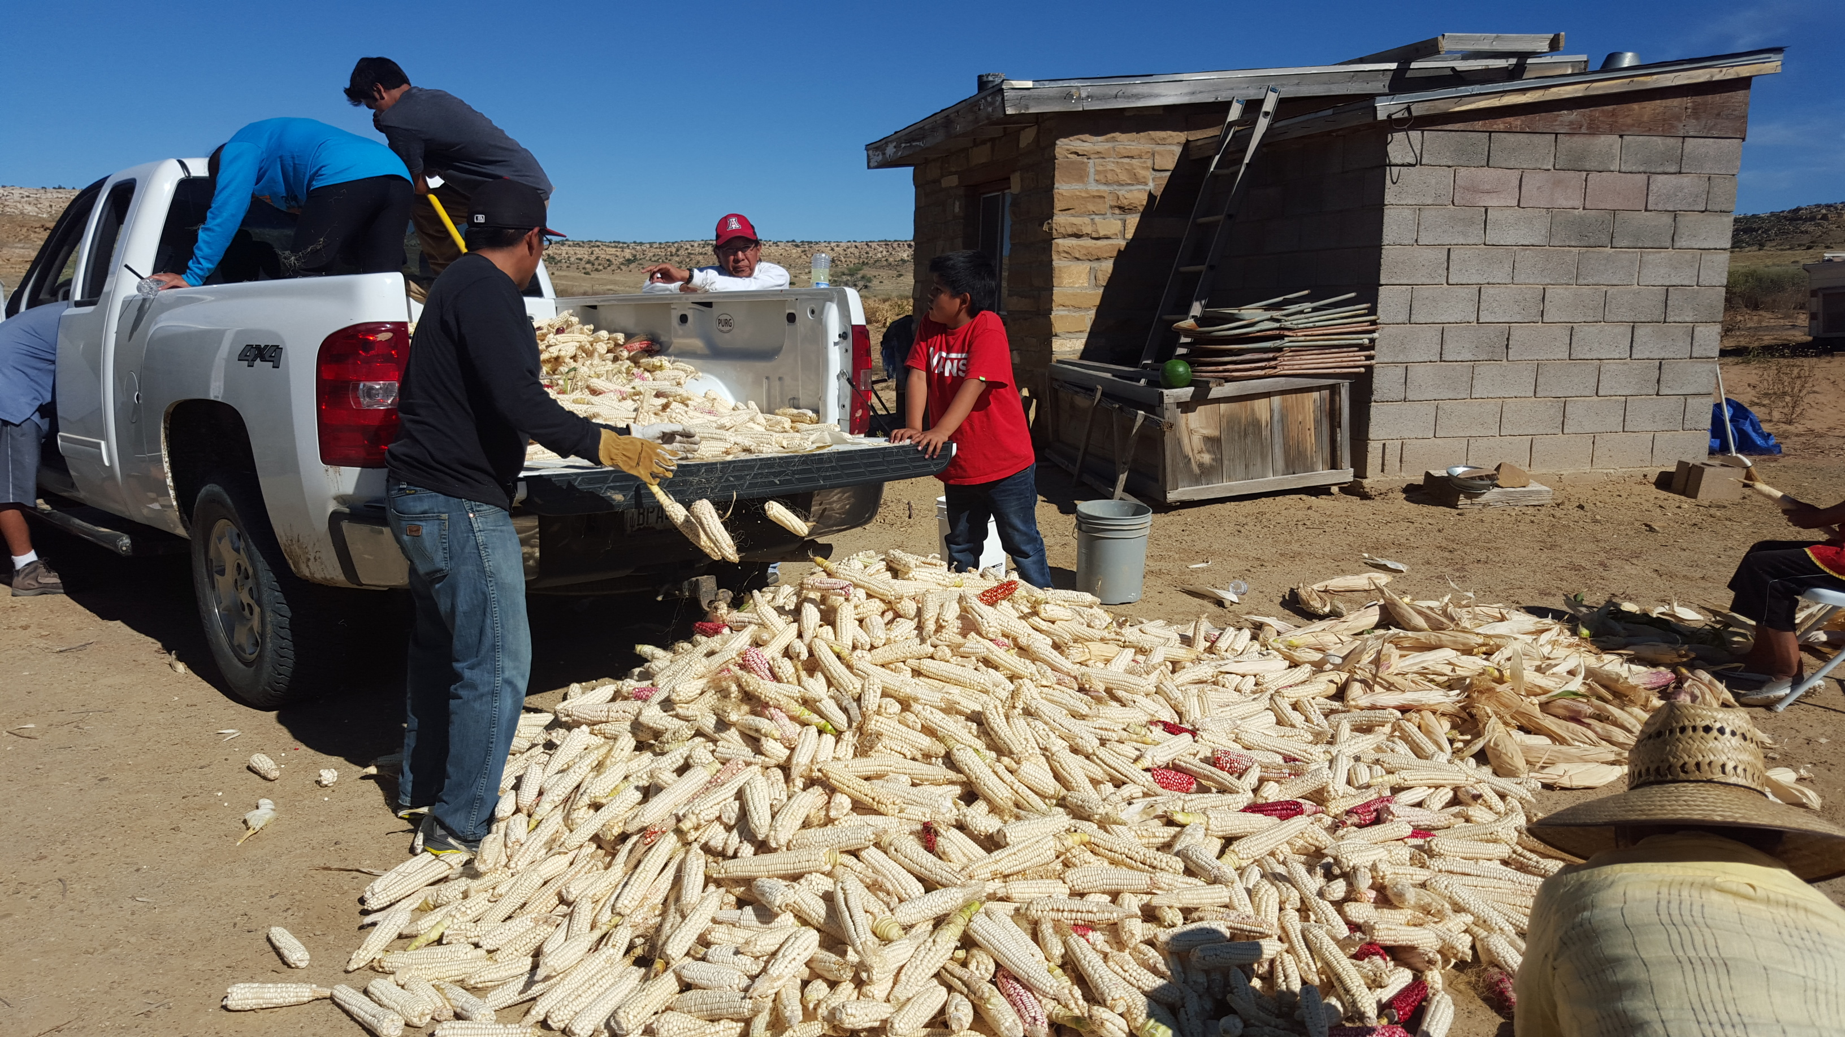

Slide 33
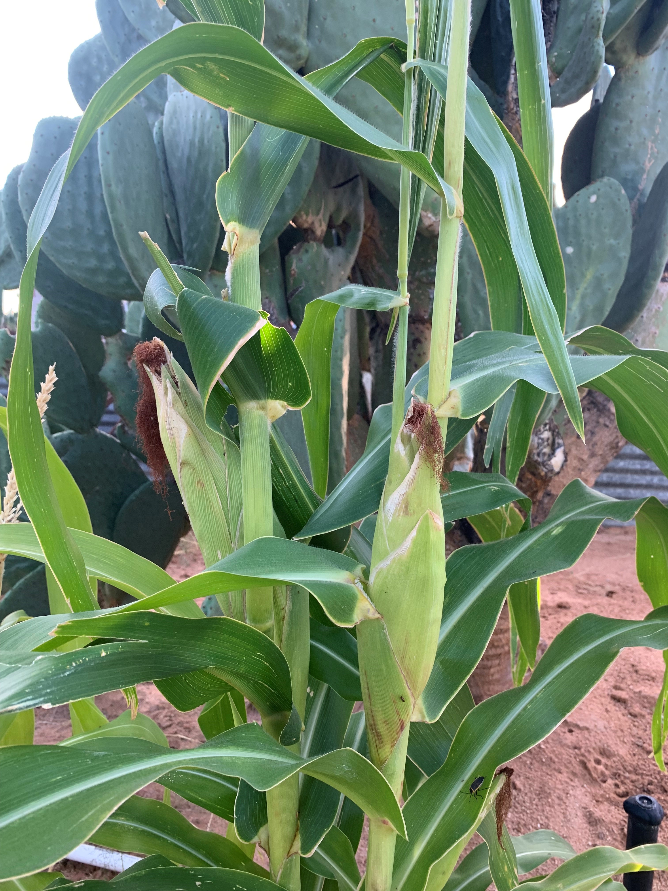

Slide 34
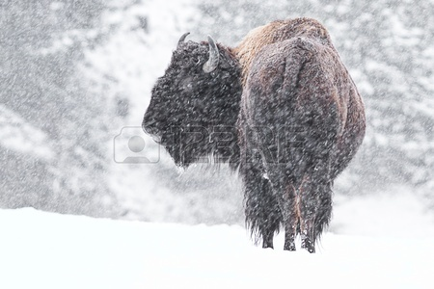
Buffalo’s role in Preventing, Mitigating and Adapting to Climate Change
Buffalo withstand a range of climate conditions
They protect Native grasses which prevent erosion, hold soil moisture
Local food sources have a lower “carbon footprint”
Buffalo Nations Treaty, 2014
Buffalo will be the basis for Tribal Nations’ food sovereignty, health, and cultural survival in the future
In October 2015, 100,000 cattle died in an early blizzard in South Dakota. No buffalo deaths were reported!

Slide 35
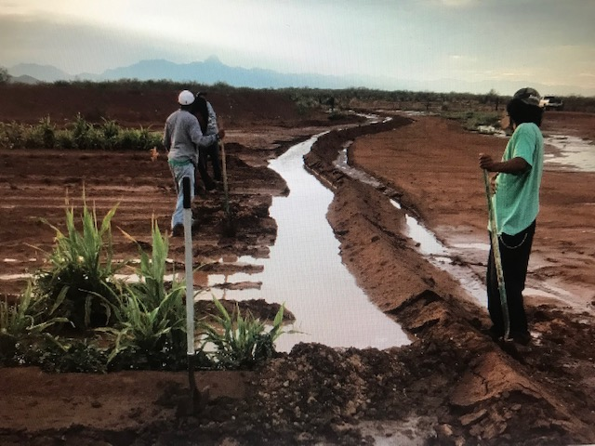
Traditional Irrigation, Water-saving and Protection Methods
Tohono O’odham Nation, Sonora Desert, Arizona

Slide 36
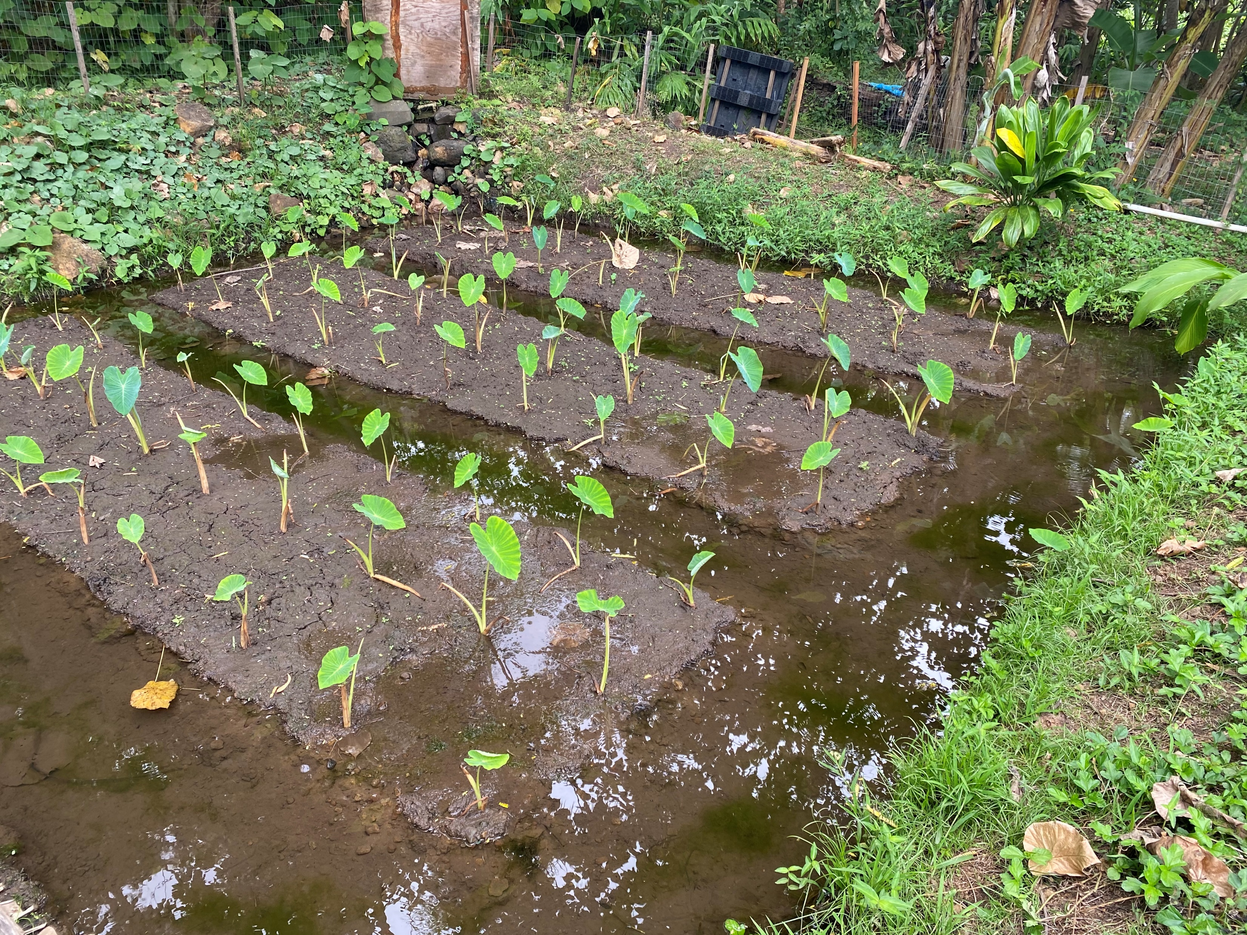
Restored Traditional Taro Bed, Pu’uhonua Village, Oahu Hawaii

Slide 37
Strengthening Intergenerational Knowledge - Sharing
Ya Ne Dah Ah Tribal School, Chickaloon Village, Alaska

Slide 38
Affirming Free Prior and Informed Consent to Stop Fossil Fuel Developments

Slide 39
Loss and Damage: 28 Indigenous Knowledge holders presented to States at COP 26
“The seasons we have always known are changing, and the weather is more extreme and unpredictable. Due to the changing climate, we are seeing new animals, insects, fish, plants and birds coming into our territories. Some are invasive, push out the Indigenous species, destroy original biodiversity and forests, and carry disease. At the same time, many of those we have always depended upon are disappearing. We are experiencing droughts, flooding, forest fires, rising sea levels and melting ice, threatening the productivity and life cycles of our lands, waters and food sources. Our rivers and lakes are drying up, and we cannot drink the water anymore.
The loss and damage we have suffered from the impacts of climate change is already extreme and is both economic and non-economic and directly affects knowledge systems and ways of life. While no price can be put upon what we have already lost and all that is threatened, adequate, direct financial resources would greatly assist Indigenous communities to adapt to these losses, restore what we can and protect and strengthen the resiliency of what remains.”

Slide 40
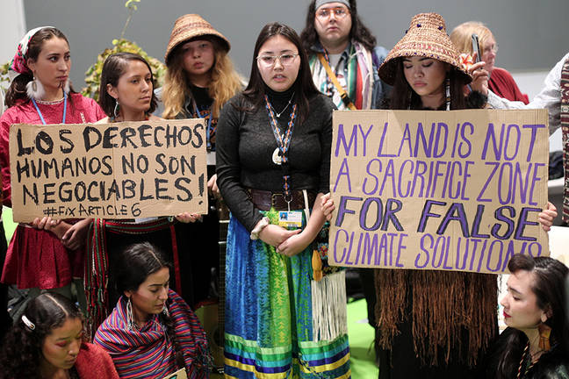
Article 6 of the Paris Rulebook: Including Indigenous Peoples’ rights in Climate Action was a significant advance at COP 26. At COP 27 we will focus on a complaint mechanism.
Indigenous Youth COP 25, Madrid, December 2019

Slide 41
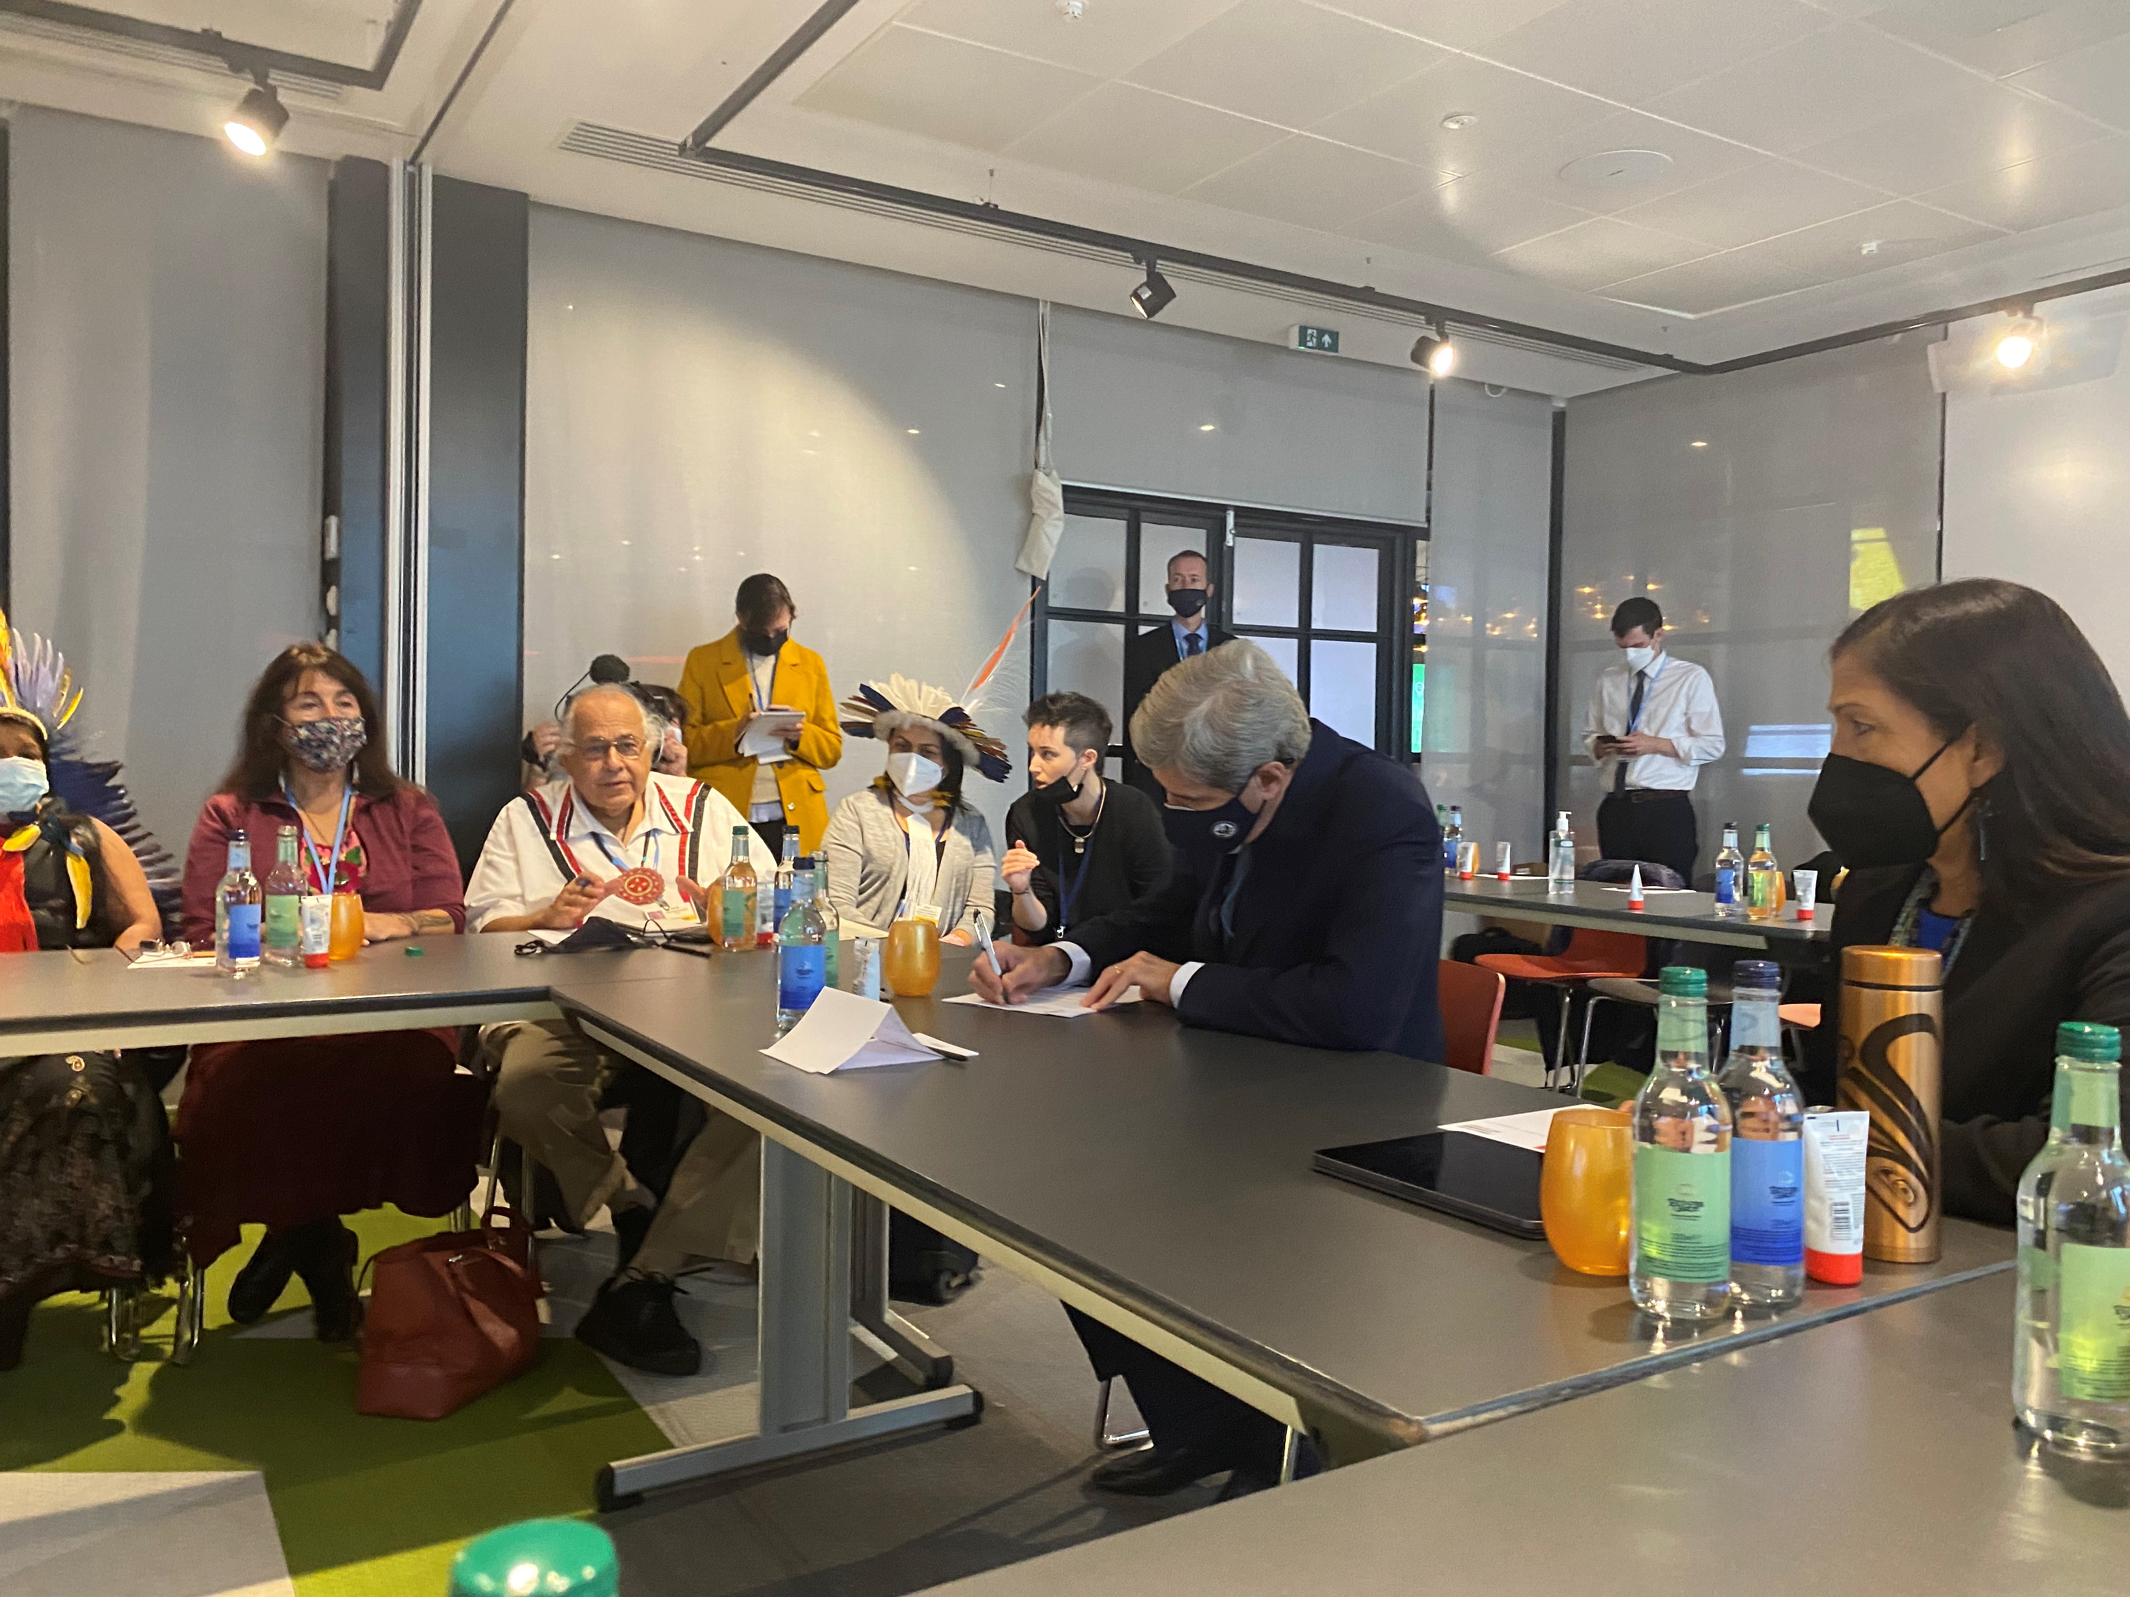
Are they finally listening?

Slide 42
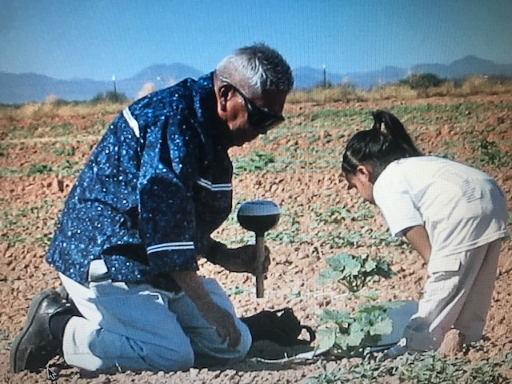
Choque Utesia, Thank you very much

Slide 43
Q&A

Slide 44
Entry points into UNFCCC negotiations and agenda for COP27
Graeme Reed, International Indigenous Peoples Forum on Climate Change

Slide 45
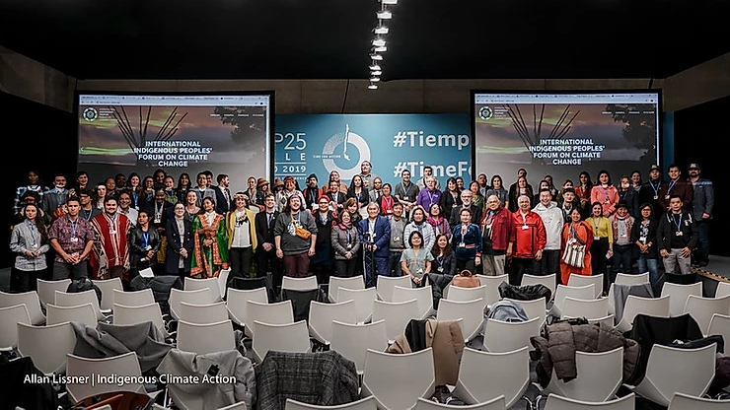
GRAEME REED OCTOBER 27, 2022
OPPORTUNITIES FOR INDIGENOUS PEOPLES AT THE UN FRAMEWORK CONVENTION ON CLIMATE CHANGE (COP 27)
Notes:
Acknowledge – Elder, – acknowledge the those who are not with us, the survivors, the families and all those who shared their stories of pain, grief, and resilience. Chi-miigwech, Much like the grandmothers guided their work, so to has my grandmother, mother, sister, aunties (Jibby, Sara, Lorraine, Renee, Danika, Barb), work family. I acknowledge and appreciate their love, guidance, and support (and endless teachings)

Slide 46
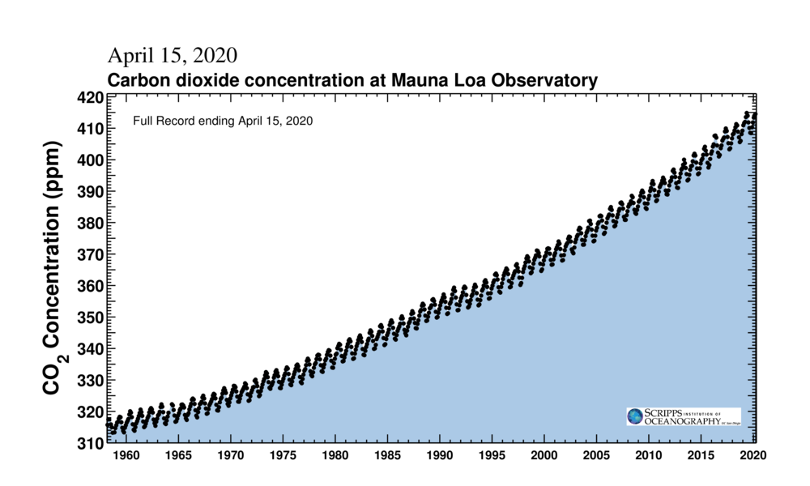
WHERE WE’RE AT (….NOT LOOKING GREAT)
WE’RE
HERE
Notes:
Out of balance, a problem of human values.

Slide 47
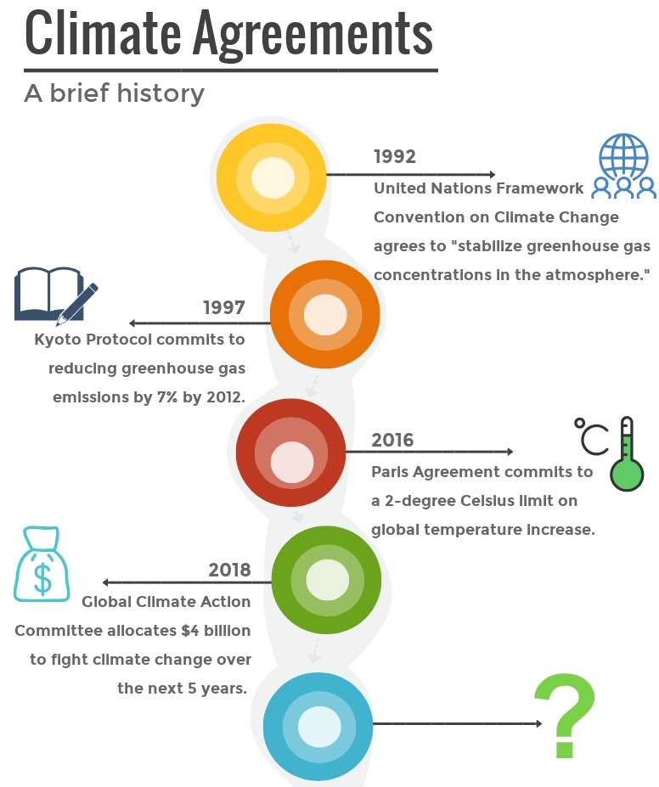
BRIEF HISTORY OF THE UNFCCC
PARIS AGREEMENT
Adopted by consensus in December 2015, ratified on 4 November 2016
Commits to keep “…global temperature rise this century well below 2 degrees Celsius above pre-industrial levels and to pursue efforts to limit the temperature increase even further to 1.5 degrees Celsius”
Designed to let Parties develop, communicate, and monitor their own Nationally Determined Contributions (NDCs), but importantly, they are not binding
6 references to Indigenous Peoples in the Paris Agreement, most notably the reference to “the rights of Indigenous Peoples”
Notes:
Aujourd'hui, je vais aborder trois sujets
Une introduction aux concepts de la justice climatique d'un point de vue autochtone, en soulignant le lien entre la terre, les gens et le plus-que-les-hommes.
Une transition vers une discussion sur l'histoire de la participation autochtone au CCNUCC, les bons et les mauvais côtés (en avant-première, c'est un espace très colonial pour les peuples autochtones).
Et enfin, parler de la COP 26 et du programme et des priorités pour les peuples autochtones. Traduit avec www.DeepL.com/Translator (version gratuite)

Slide 48
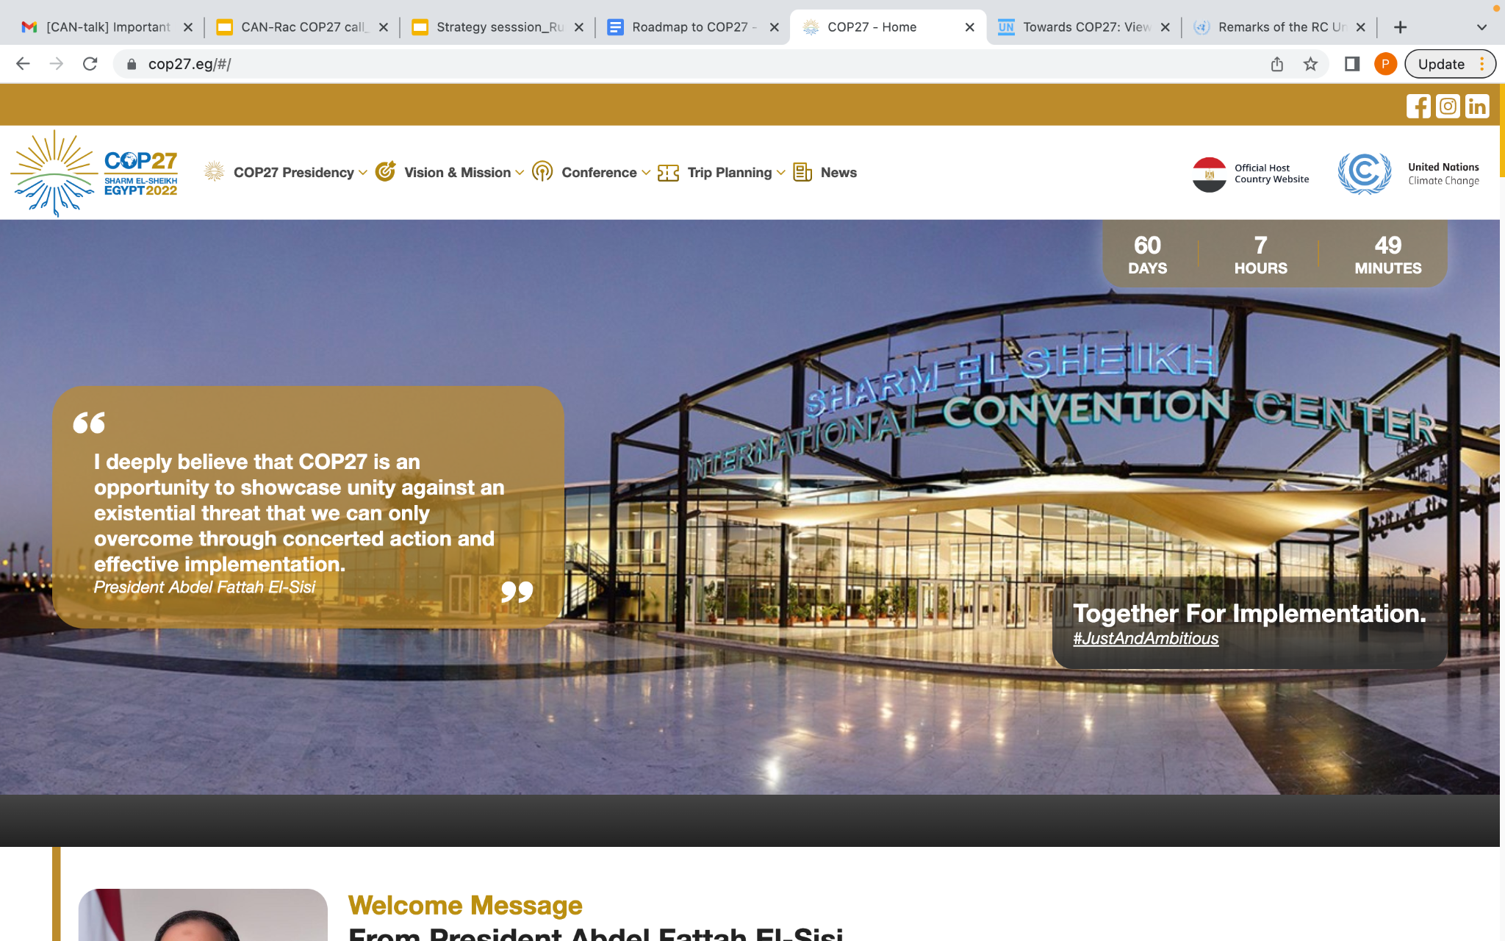
COP 27 IN SHARM-EL-SHEIKH
Framed as an ‘implementation’ COP, offering governments the chance to come together move beyond geopolitical rivalries – and working with civil society – to respond together to the threats through:
Implementation: demonstrating implementation on climate promises of the past
Collaboration: agreeing on new forms of collaboration to tackle these intersecting crises; both inside the UNFCCC and outside the UNFCCC, beyond the traditional ‘climate’ agenda.
Geopolitical dynamics

Slide 49
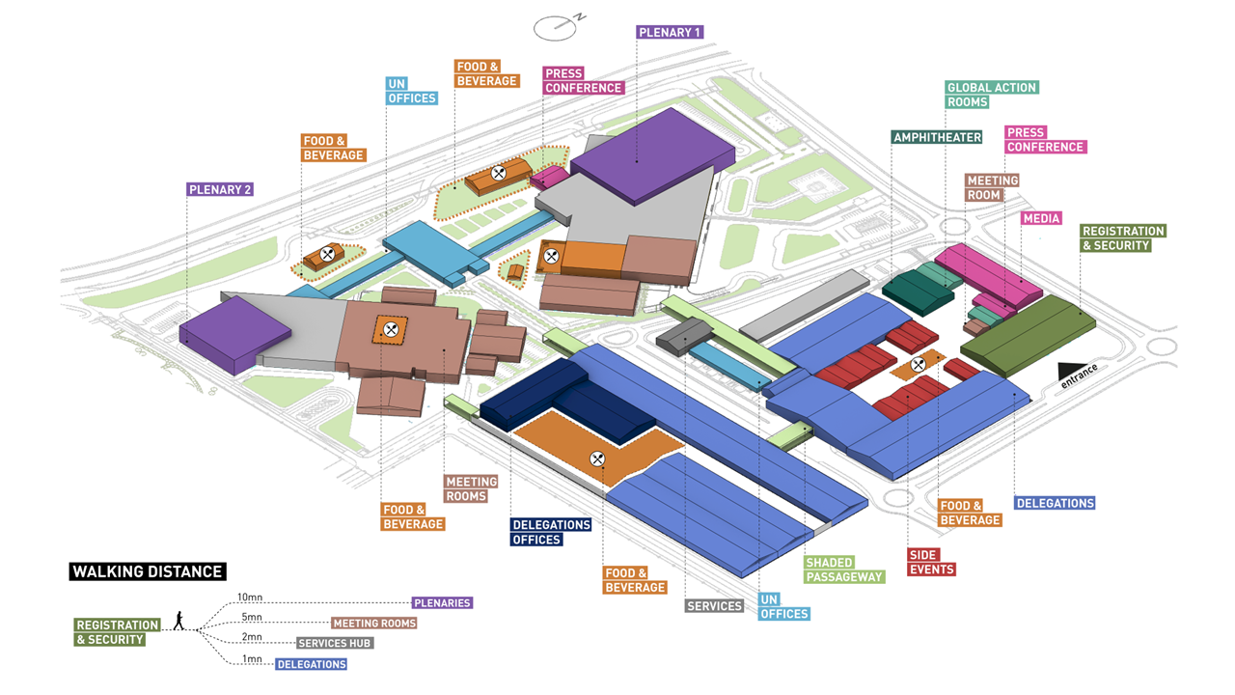

Slide 50
Notes:
Becoming a UNFCCC Delegate - What you need to know guide for LDCs

Slide 51
KEY DATES - GENERAL
Nov 5 – 6: Indigenous Caucus Preparatory Meeting
Nov 6: Opening of the Session (Indigenous Peoples constituency will be asked to deliver a statement)
Nov 7 – 8: World Leader’s Summit (Sharm-El-Sheikh Climate Implementation Summit)
Nov 14: Fifth biennial high-level ministerial dialogue on climate finance & High-level ministerial roundtable on pre-2030 ambition
Nov 15: Part 2: High-Level Segment
Nov 18/19: Closing of the Session (Indigenous Peoples constituency will be asked to deliver a statement)

Slide 52
REMINDER: LCIPP THREE-YEAR WORKPLAN (2022 – 2025)
KNOWLEDGE
CAPACITY FOR ENGAGEMENT
CLIMATE POLICIES & ACTIONS
CROSS-CUTTING
Activity 1:
Annual gatherings
at COP
Activity 4:
Training workshops for indigenous peoples and local communities
Activity 6:
Collaboration with other CBs
Activity 8:
Youth Roundtable
Activity 2:
Regional gatherings
Activity 5:
Training workshops for Parties and stakeholders
Activity 7:
Multi-stakeholder workshop at COP
Activity 9: Communication
Activity 3:
Curricula and Education
=OCCURRING AT COP 27 IN EGYPT
Notes:
Aujourd'hui, je vais aborder trois sujets
Une introduction aux concepts de la justice climatique d'un point de vue autochtone, en soulignant le lien entre la terre, les gens et le plus-que-les-hommes.
Une transition vers une discussion sur l'histoire de la participation autochtone au CCNUCC, les bons et les mauvais côtés (en avant-première, c'est un espace très colonial pour les peuples autochtones).
Et enfin, parler de la COP 26 et du programme et des priorités pour les peuples autochtones. Traduit avec www.DeepL.com/Translator (version gratuite)

Slide 53
KEY DATES - LOCAL COMMUNITIES AND INDIGENOUS PEOPLES
PLATFORM
Nov 1 - 4 : 8th meeting of the FWG of the LCIPP
Nov 7 (Part 1: 10:00 – 18:00): Annual meeting with the participation of indigenous peoples and traditional knowledge holders (Activity 1)
Nov 8 (Part 1: 13:00 – 18:00): Annual roundtable with Indigenous youth and youth from local communities (Activity 7)
Nov 9 (14:00-17:00): Multi-stakeholder Dialogue, strengthening participation of indigenous people and local communities in research and scientific processes related to climate change
Nov 10 (Part 2: 14:00 – 16:00): Annual meeting with the participation of indigenous peoples and traditional knowledge holders (Activity 1)
Nov 11 (Part 2: 14:00 - 16:00): Annual roundtable with Indigenous youth and youth from local communities (Activity 7)

Slide 54
KEY THEMES DISCUSSED AT COP 27
Mitigation =
Measures to limit climate change and its effects
ie. reduce emissions / increase sinks
→ Prevention
Adaptation =
Measures to limit our vulnerability to climate change
ie. accept that climate change is already happening & adapt to it
→ Response
Loss & Damage =
Addressing climate impacts that are not avoided through mitigation or adaptation
→ Reparation
Finance

Slide 55
KEY NEGOTIATION AREAS AT COP 27
Mitigation =
Global Stock Take
Article 6 - Independent Grievance Mechanism
Mitigation work plan
Adaptation =
Glasgow-Sharm-El-Sheikh workplan on Global Goal on Adaptation
Loss & Damage =
Loss and Damage Facility
Operationalizing Santiago Network
Finance =
Support for Loss and Damage
$100 Billion Pledge (repleshiment in 2023)

Slide 56
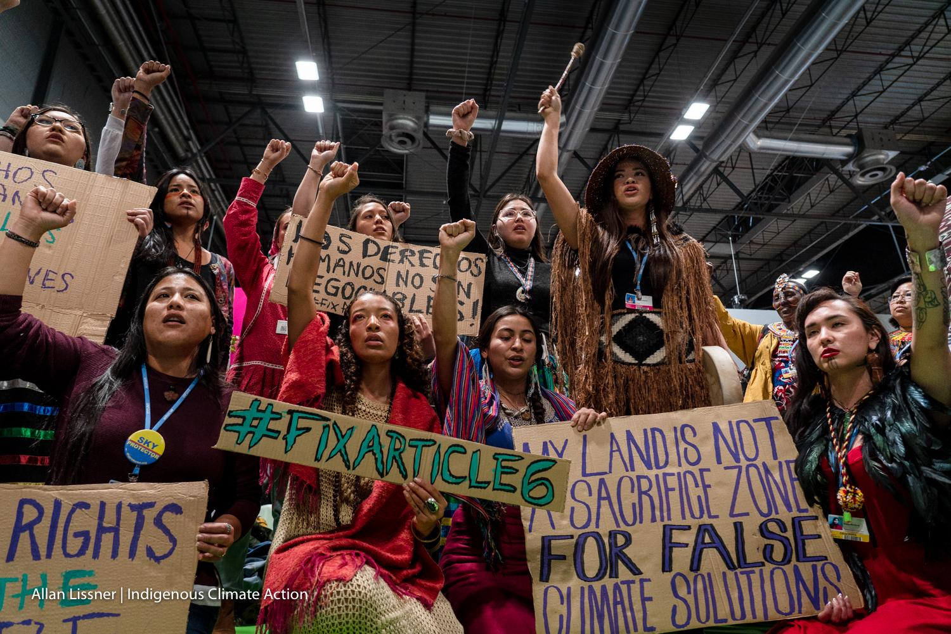
INDIGENOUS PRIORITIES FOR COP 27
Continue advancing an Indigenous-rights based approach, building on the new three-year work plan of the Platform and the references to Indigenous Peoples in the Glasgow Climate Pact.
Leverage the adoption of rights-protections in Article 6 to ensure Indigenous-specific guidelines (rights-based) inform the mechanism’s implementation.
Use the Global Stock take and Ambition mechanisms to ramp up urgent and transformative climate action in line with a 1.5-degree future
COP 27 in Egypt, heralded as the Adaptation and Loss and Damage COP, will be an important opportunity to advance Indigenous-led solutions to adaptation and loss and damage, amplifying the voices of Indigenous elders, women, knowledge keepers, experts, youth, and leadership
Facilitator: Graeme Reed

Slide 57
ENTRY POINTS FOR INDIGENOUS PEOPLES (PART I)
Established in 2008
Organisation that holds the Caucus for Indigenous Peoples participating in UNFCCC Processes
Annual COP Conferences
Intersessional sessions of SBSTA/SBI in between COPs
Indigenous Peoples’ Constituency…

Slide 58
ENTRY POINTS FOR INDIGENOUS PEOPLES (PART II)
Many constituencies, such as…
BINGO * & ENGOs*
LGMA* COP1, 1995
IPO* COP7, 2001
RINGO* COP9, 2003
TUNGO* before COP14/CMP 4, 2008
YOUNGO*, Women & Gender before COP17/CMP 7 in 2011
Farmers - provisional
To date Constituencies in UNFCCC have mirrored 9 x “Major Groups” in Agenda 21
Some admitted orgs outside Constituencies eg. faith groups, national parliamentarians etc.
Disabled Peoples on pathway to recognition as constituency
90%

Slide 59
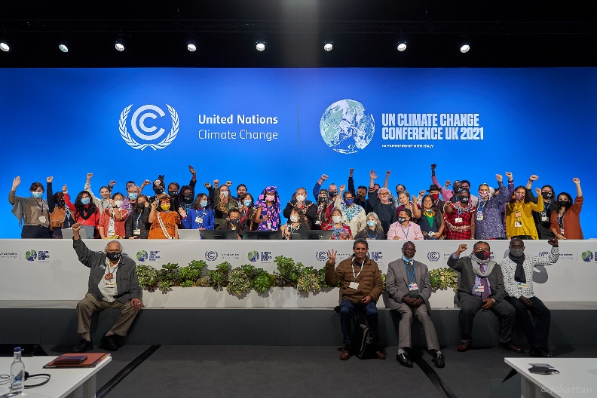
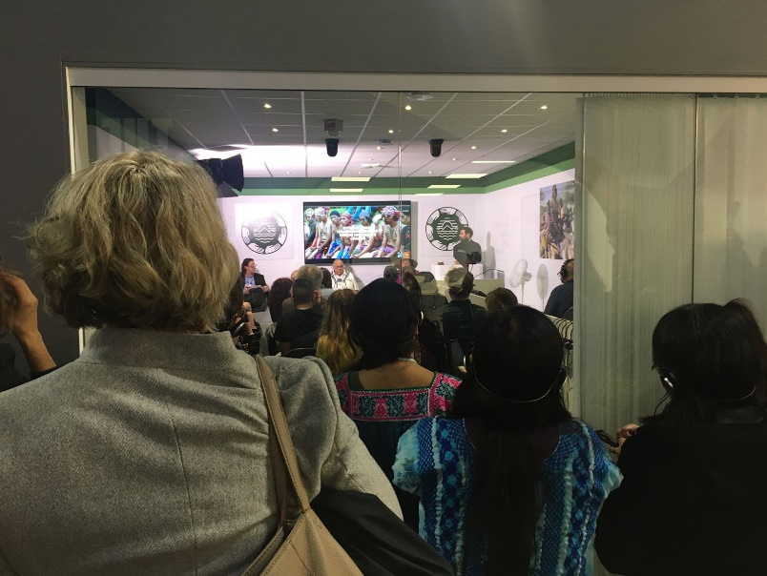
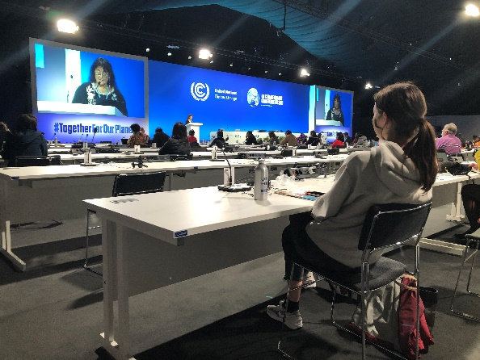
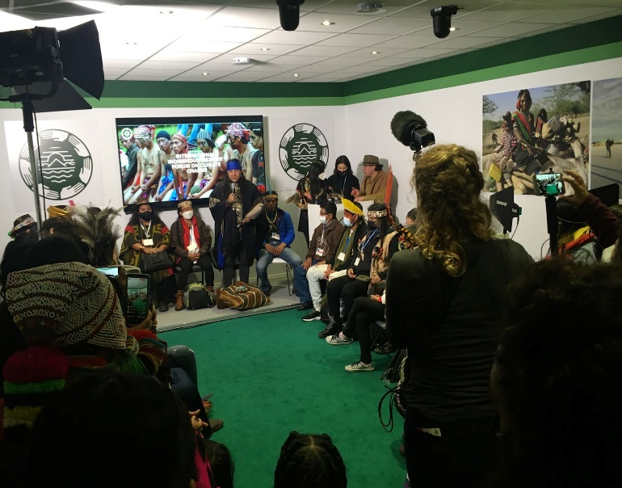
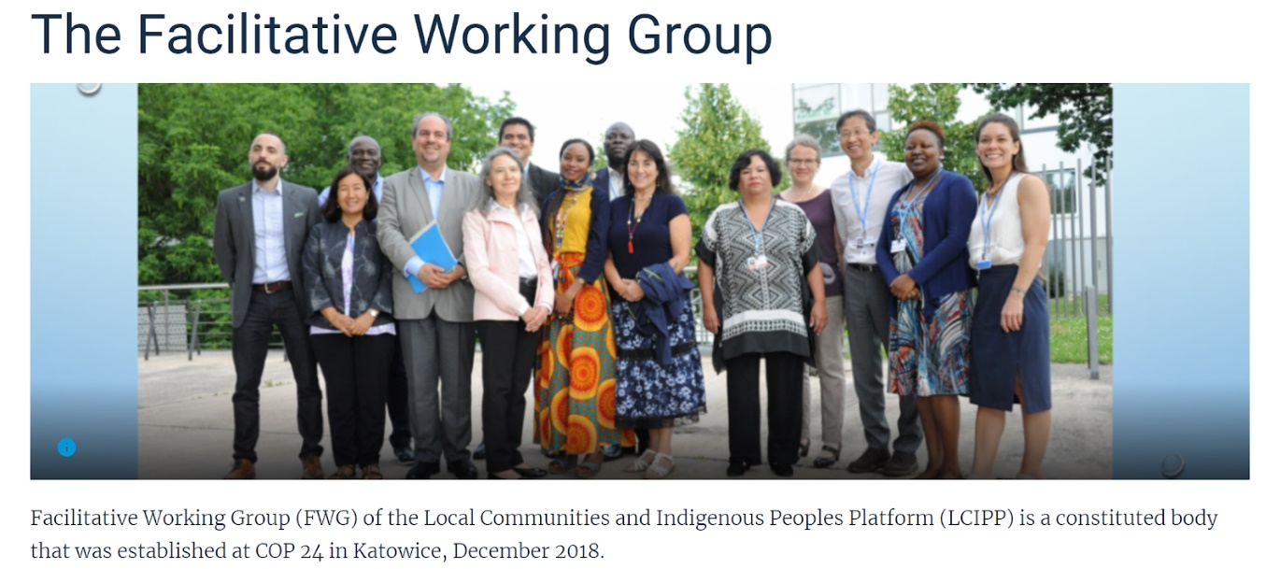
INDIGENOUS PEOPLES RECLAIMING SPACE
Indigenous Peoples Pavilion at COP 26
Find more on our Facebook and https://www.iipfccpavilion.org/
Annual Knowledge Keepers Gathering at COP 26
Find more here: https://lcipp.unfccc.int/
Notes:
Aujourd'hui, je vais aborder trois sujets
Une introduction aux concepts de la justice climatique d'un point de vue autochtone, en soulignant le lien entre la terre, les gens et le plus-que-les-hommes.
Une transition vers une discussion sur l'histoire de la participation autochtone au CCNUCC, les bons et les mauvais côtés (en avant-première, c'est un espace très colonial pour les peuples autochtones).
Et enfin, parler de la COP 26 et du programme et des priorités pour les peuples autochtones. Traduit avec www.DeepL.com/Translator (version gratuite)

Slide 60
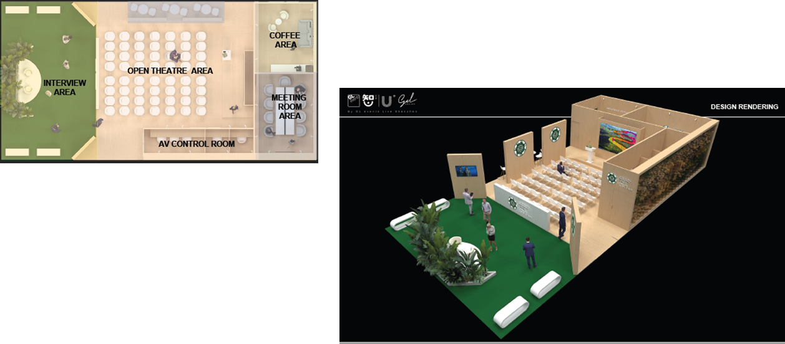
INDIGENOUS PEOPLES PAVILION

Slide 61
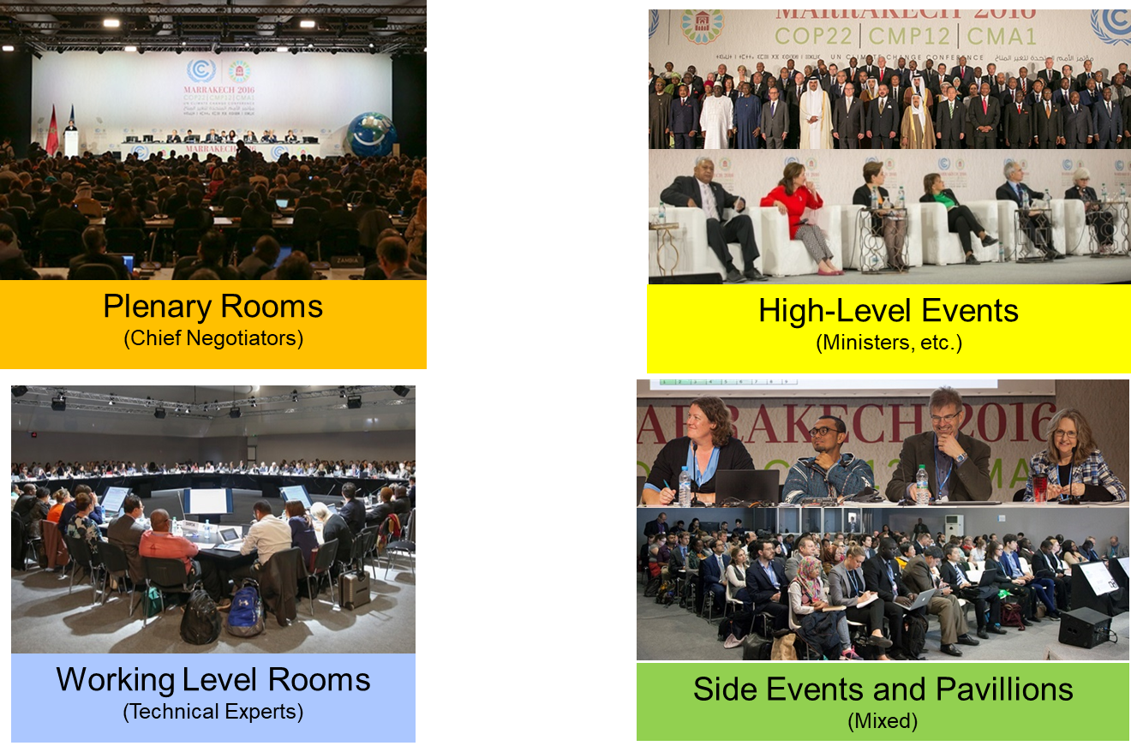
ENTRY POINTS FOR INDIGENOUS PEOPLES (PART III)

Slide 62
HOW DO NEGOTIATIONS ACTUALLY WORK?
CONTACT GROUPS
SESSION AGENDA
DECISIONS
Loss & Damage
COP
SBSTA SBI
SBSTA SBI
COP
Article 6
Adaptation
GST
Cover Text
OPPORTUNITY TO INFLUENCE

Slide 63
WHAT DOES A NEGOTIATION ROOM LOOK LIKE?
Co-Facilitators
Parties
Take the floor to express their views
Propose language [new language]
Agree or disagree with previous proposals
Observers
Can’t take the floor to express our views directly
Try to influence party negotiators
What happens?
Consensus 🡪 Approved in the room and goes to SB for adoption
No consensus 🡪 Forwarded to SB for more negotiation
Ministers usually arrive second week
PARTIES
CO-FACILITATORS
OBSERVERS

Slide 64
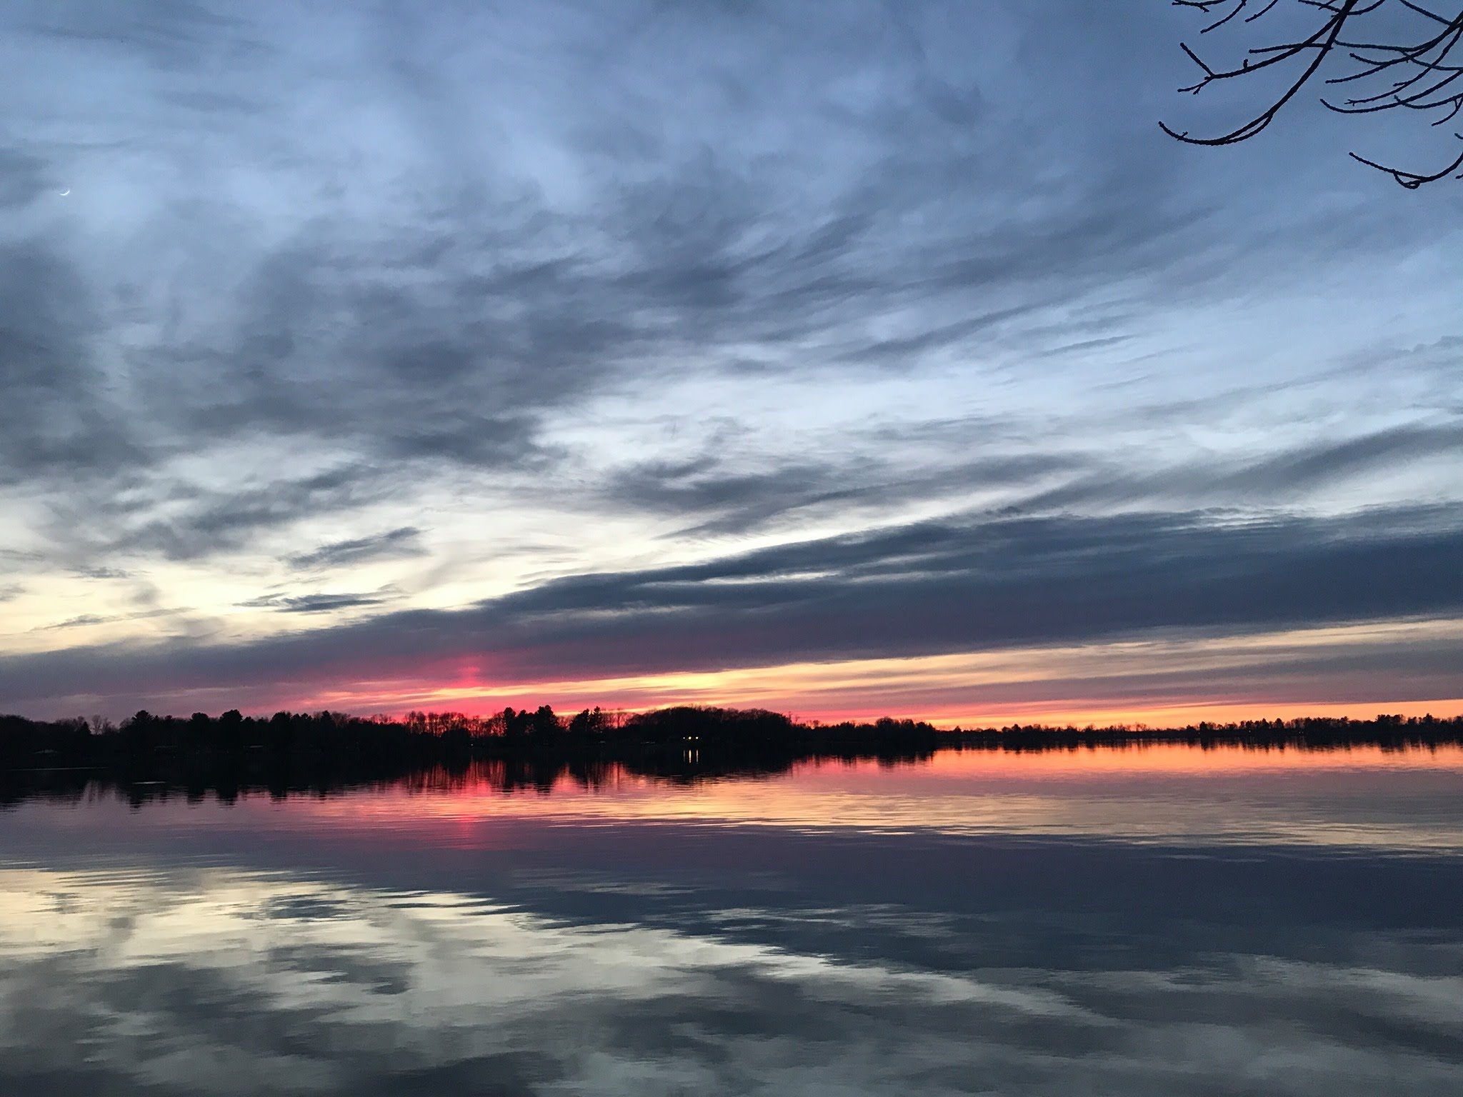
CHI-MIIGWECH QUESTIONS?
Lake Dalrymple, Ontario

Slide 65
Q&A

Slide 66
NDCs and UNDPs Climate Promise
Sameera Savarala, Verania Chao Lorenzo Eguren, UNDP Climate Strategy and Policies Team

Slide 67
NDC101: Nationally Determined Contributions, Paris Agreement and Social Inclusion in the UNDP Climate Promise Sameera Savarala, Programme Specialist, Climate Strategies and Policy Team Verania Chao, Programme Specialist, Climate Strategies and Policy Team Lorenzo Eguren, Regional Country Coordinator, Climate Strategies and Policy Team

Slide 68
The Paris Agreement & the NDCs
The Paris
Agreement
Aims to limit global warming well below 2°C by 2100, preferably to 1.5°C compared to pre/industrial levels.
Established a process, known as “intended nationally determined contributions, or INDCs” by which countries increase their efforts to reduce emissions and increase resilience over time to achieve the long-term temperature goal.
Countries have been requested to prepare, communicate, and implement subsequent NDCs every five years.
Successive NDCs represent a progression beyond the current NDC and reflect the Party’s highest possible ambition.
NDC
If fully implemented, NDCs can contribute significantly to reducing warming.

Slide 69
What are NDCs in the context of the Paris Agreement?
2011
Conference of Parties 17 Durban
(South Africa)
A process was established to develop a protocol or other legal instrument under the climate change convention
To complement this agreement with specific actions by countries and Parties contributing to global climate goals, the COP invited all Parties to prepare intended nationally determined contributions (INDCs)
2015
Paris Agreement
Paris (France)
147 Parties had responded to this invitation by communicating, within their INDCs, their plans to reduce emissions and adapt to climate change through a variety of targets and actions.
2013
COP 19
Warsaw (Poland)
Nationally determined contributions (NDCs) are at the heart of the Paris Agreement (PA)
They embody efforts by each country to reduce national emissions and adapt to the impacts of climate change.
Notes:
128 Countries have submitted new NDC targets (127 countries plus the EU) as of Dec 2021
This version of the NDC synthesis report synthesizes information from the 166 latest available NDCs, representing 193 Parties to the Paris Agreement, including the 142 new or updated NDCs communicated by 169 Parties, recorded in the NDC registry as at 23 September 2022, covering 94.9 per cent of the total global emissions in 2019, which are estimated at 52.6 Gt CO2 eq without LULUCF. A total of 39 Parties have communicated new or updated NDCs since 12 October 2021 (the cut-off date for submissions covered in the previous version of this report), 24 of which after COP 26.

Slide 70
What are NDCs in the context of the Paris Agreement?
PARIS AGREEMENT. Nationally Determined Contributions (Art. 3 and 4.2)
The agreement requests that Parties prepare, communicate, and implement NDCs every five years.
Each government decides, based on its circumstances and capacities, the actions it will take to contribute to achieving the objectives of the agreement.
National Determined Contributions
Vision, Integration and Ambition
They should reflect the short- and medium-term measures countries will undertake to reduce national emissions and increase resilience
Ideally, they should be fully integrated into a country’s policies and plans
Parties should consider the vision enshrined in their own long-term strategy, if they have one, as well as the results of the global stocktake* under the PA
*A process by which the international community will collectively evaluate progress toward achieving the objectives of the PA

Slide 71
Milestones
In 2018
The UNFCCC convened the Talanoa Dialogue, to take stock of collective efforts toward the agreement’s long-term goal and inform of the next NDCs, due in 2020
Parties have been asked to communicate by 2020 a new NDC (if their first NDC ends in 2025) or an updated one (if their first NDC ends in 2030). They will continue to do so every five years.
In 2023
A global stocktake is to take place, with a preparatory stage commencing in 2021, assessing collective progress toward achieving the agreement.
In 2020
In 2024
The enhanced transparency framework will enter into full implementation phase, at the latest by December 2024, when the first biennial transparency reports are submitted.
A key input to this dialogue was the Intergovernmental Panel on Climate Change (IPCC) special report on the implications of the 1.5°C goal.
COP26 final decision encourages Parties to communicate in 2025 an NDC with an end date of 2035, in 2030 an NDC with an end date of 2040, and so forth, every five years thereafter. Therefore, NDCs will be updated every 5 years, with 10-year timeframes.
A stock take will take place every five years, in time to inform the next round of NDCs.

Slide 72
UNFCCC NDC Synthesis Report Results
166 latest available NDCs, representing 193 Parties to the Paris Agreement, including the 142 new or updated NDCs communicated by 169 Parties, recorded in the NDC registry as of 23 September 2022
Covering 94.9% of the total global emissions in 2019
A total of 39 Parties have communicated new or updated NDCs since 12 October 2021, 24 of which after COP 26
Shows some increased ambition but not enough to limit temperature rise to 1.5 degrees C
Combined climate pledges of 193 Parties under the Paris Agreement could put the world on track for around 2.5 degrees C of warming by the end of the century
Current commitments will increase emissions by 10.6% by 2030, compared to 2010 levels compared to last year’s assessment, which found countries were on a path to increase emissions by 13.7% by 2030, compared to 2010 levels
Still need significant emissions reductions
Notes:
CO2 emissions needed to be cut 45% by 2030, compared to 2010 levels

Slide 73
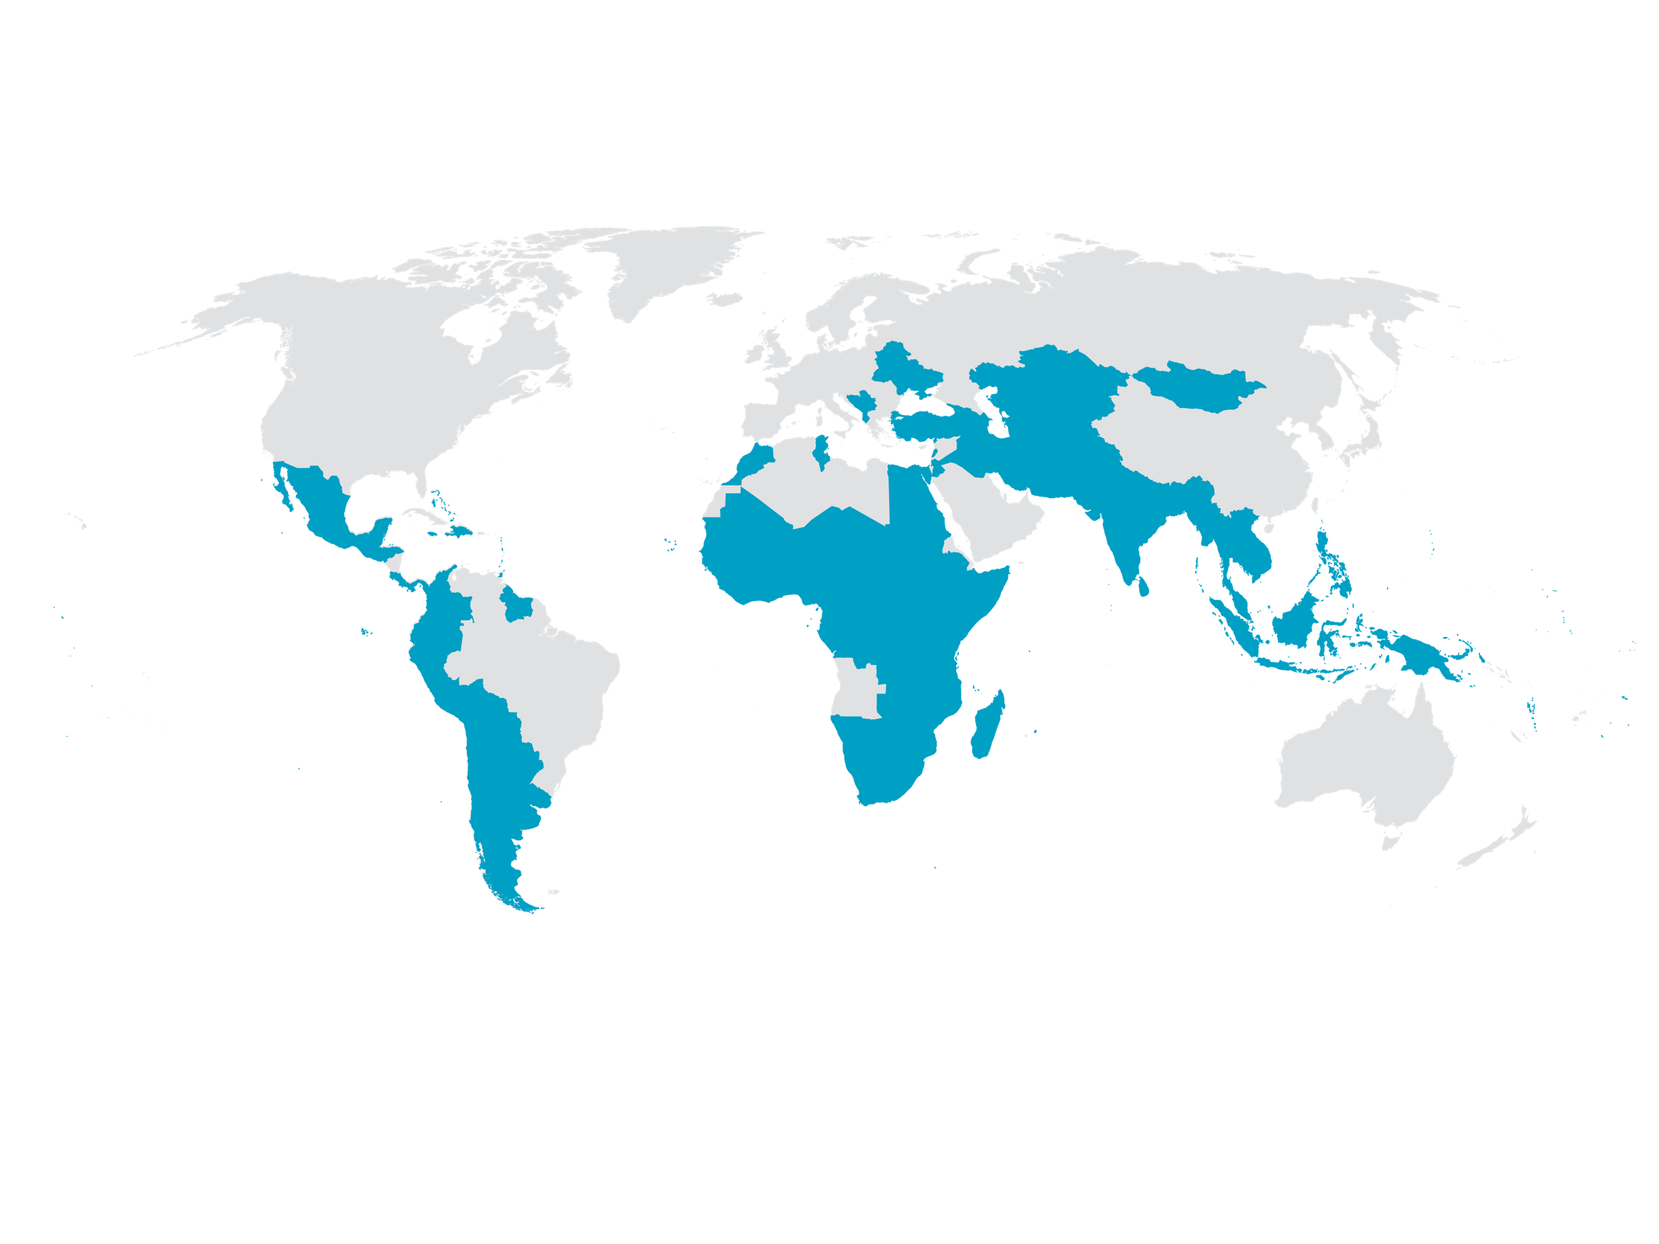
The Climate Promise: Portfolio to date
The world's largest offer of support to countries on NDCs and a contribution to the NDC Partnership

Slide 74
The Climate Promise: Overall Results to date
97
countries are establishing and/or strengthening policies, institutions, and capacities for effective NDC implementation
86
countries are identifying and mobilizing resources to realize NDC targets
46
countries developing National Adaptation Plans (NAPs) and related planning and capacity building processes
56
countries developing financing strategies or investment plans
countries advancing formulation of NDC implementation roadmaps/strategies​
40
55
countries conducting assessments to inform financing frameworks and investment opportunities
24
countries preparing new and/or strengthening existing climate policies and legislation

Slide 75
The Climate Promise: Overall Results to date
97
countries are advancing systems to monitor and report on climate action
67
countries are mainstreaming NDC priorities and measures into development plans and strategies, including with SDGs
41
countries building and improving GHG inventory systems
42
countries strengthening linkages between NDCs and SDGs
75
countries designing and/or updating Measuring, Reporting, and Verification (MRV) systems/adaptation M&E systems, including capacity building
34
countries mainstreaming NDC targets into national, sub-national, and/or sectoral development plans/budgets
11
countries developing financial tracking and budget tagging mechanisms

Slide 76
The Climate Promise Key Results as of September 2022
As of September, 102 Climate Promise countries submitted enhanced NDCs, representing over 20% of global GHG emissions and 84% of all developing country submissions
Over 90% increased mitigation ambition, 100% include energy
96% increased adaptation ambition, many link to NAPs
95% included gender considerations
72% refer to gender in specific sectors, up from 16% in the initial round of NDCs
97% included youth considerations
100 countries organized multi-stakeholder consultations including with women's and indigenous organizations in NDC revision process
49 countries have conducted gender analyses including on IPLC

Slide 77
Climate Promise results to date on Gender
Selected countries made specific reference to gender equality in their updated NDC and implemented actions on the ground:
Countries have supported strong coordination mechanisms through linking climate change ministries and gender institutions and strengthened the institutional capacity of both.
Countries have led consultations with multiple stakeholders and political buy-in to define core climate and gender considerations in their NDCS.
Countries have conducted gender analyses to identify capacity gaps and planning priorities.

Slide 78
Climate Promise results to date on Social Inclusion
Selected countries made specific reference and commitments to Indigenous Peoples in their updated NDC and implemented actions on the ground:
Countries have developed financing strategies or investment plans that include gender aspects and strengthen access to finance including for indigenous peoples
Countries have developed gender and climate action plans to identify gender-specific opportunities including for indigenous peoples
Countries have encouraged meaningful participation of indigenous people in implementing climate action through leading multi-stakeholder consultations

Slide 79
Country Examples of Social Inclusion
Panama
The national gender and climate change action plan has been finalized after a participatory process with 200 participants that included the views of afro-descendants, indigenous peoples and youth.
Gabon
Led various gender analyses on local communities and disproportionally affected groups by climate change such as young people, women and indigenous peoples. These social focused analyses have contributed to raising awareness on the NDC and climate change, but also the consideration of new farming techniques in the face of adaptation to the management of natural resources.
Colombia
launched the Climate Promise dialogues with the participation of 260 women from 18 departments to collectively build proposals to face the impacts of climate change by women including indigenous women. The results of these dialogues have served as input for the formulation of the Gender and Climate Change Action Plan.

Slide 80
Social Inclusion in the Climate Promise NDC Implementation Phase
Access of IPs to green jobs integrating gender equality and social inclusion (Burkina Faso, Central African Republic)
National Energy and Action Plans including IPs (Georgia)
Environmental loss assessment with focus on IPs (Iraq)
NDC climate financing strategies including IPs (Peru)

Slide 81
Indigenous Peoples on NDC process in LAC region

Slide 82
Context of Indigenous Peoples in LAC
Population and economic situation:
Indigenous peoples (IP) represent 8% to 10% of the population of LAC (42 million people) but constitute approximately 14.5% of the poor and 17% of the extremely poor in the region (WB 2015),
Mexico, Guatemala, Peru and Bolivia had the largest populations, representing more than 80% (34 million) . Other, large populations in Honduras, Ecuador, and Colombia.
Urban-rural distribution:
50% – 50%
Indigenous peoples and climate change:
Around 35% of the forest areas in LAC are under the influence of indigenous territories.
Key for NDC implementation as LULUCF sector represents 20% of the GHG emissions in the region and in some countries is the main source of GHG emissions.
Indigenous territories have lower average deforestation rates that other forests in practically every Latin American country.
Dependence on natural resources and the situation of poverty make IP especially vulnerable to climate change, but at the same time an important actor for mitigation and adaptation action.

Slide 83
NDC and Indigenous People
UNDP through the NDC-SP and Climate Promise supports the implementation of the NDCs in 26 countries of the LAC region and assessed the submission of 21 more ambitious NDCs during 2020-2021.
NDCs generally recognize IPs are especially vulnerable to climate change and relevant actors in the implementation of the NDC measures, especially in the forestry and agriculture sectors. (Adaptation and mitigation).
Recognition of the rights of indigenous peoples, the value and respect for traditional knowledge and their ways of life are key elements for improving well being, the preservation of forests and agricultural practices against climate change. (Adaptation and resilience)
NDC development had participatory processes where indigenous peoples have been considered and informed.

Slide 84
Peru case of indigenous participation
In Peru there was a participatory process called “Let's dialogue about the NDC” that convened main stakeholders including indigenous peoples.
For the implementation of the NDC, the regulation of the Framework Law on Climate Change was subject to a consultation process with the Indigenous Peoples where 1,433 indigenous leaders directly intervened.
Entire process was carried out in accordance with the provisions of ILO Convention 169 and the Peruvian Prior Consultation Law.
A formal permanent entity “Platform of Indigenous Peoples for Climate Change” was created as to enable IPs participation in climate change management including the High-level Commission on Climate Change where NDC measures are identified and proposed.

Slide 85
Q&A

